Slide 1
Do Now- 11/12
How does economic failure at a national level impact average citizens?
What can people do to make life better during times of struggle?

Slide 2
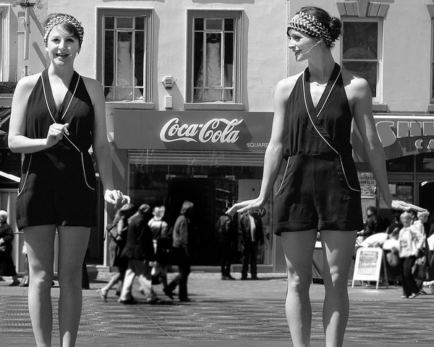
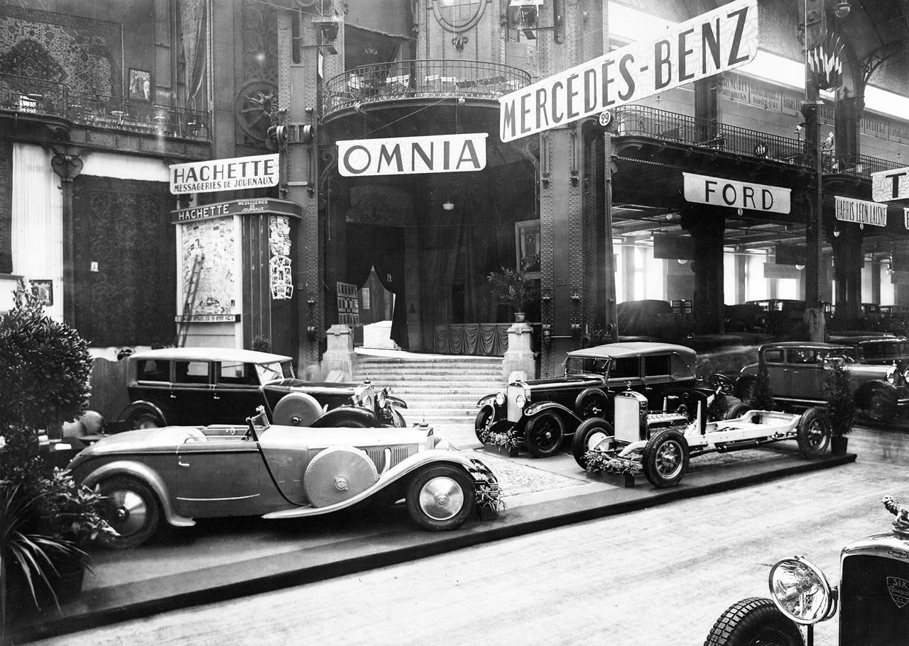
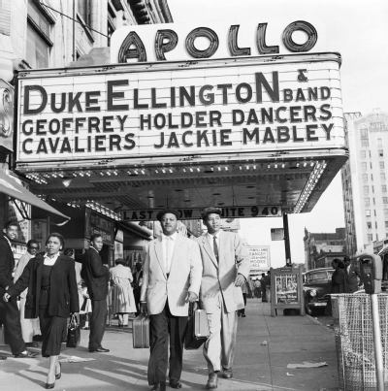
Let’s Review...
Get your phones out, go to Kahoot.it
https://create.kahoot.it/#quiz/7f44382a-20b6-464a-87bb-343e32f74f23

Slide 3
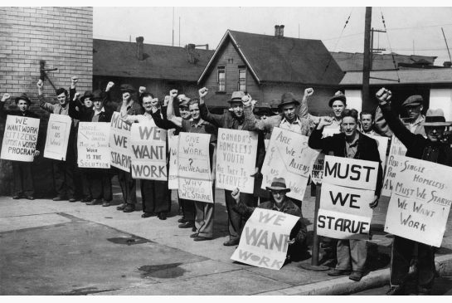
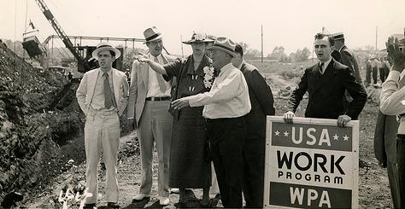
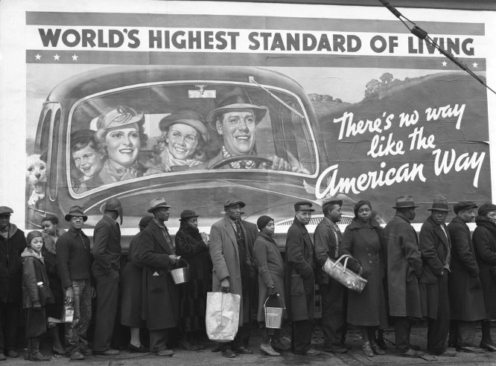
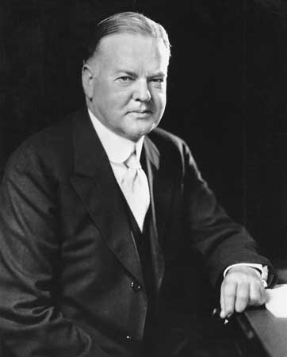
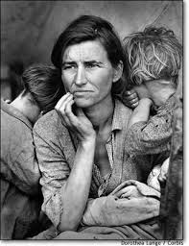
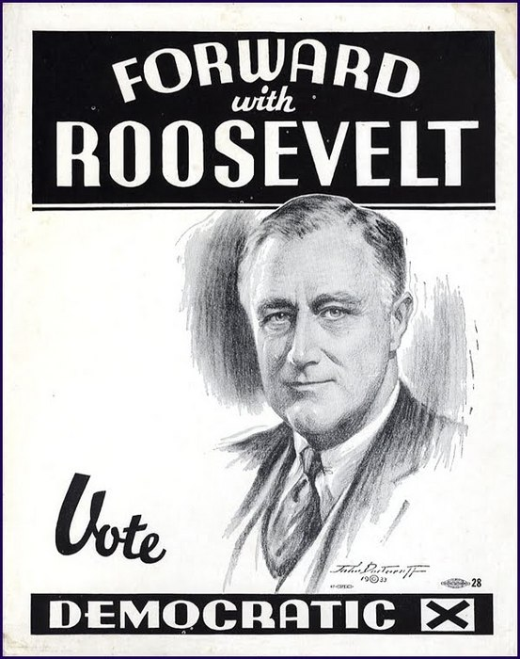
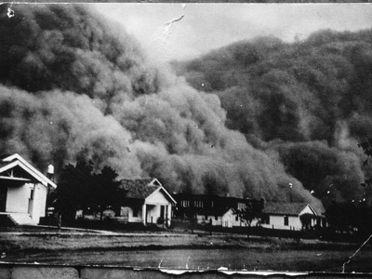
The 1930s

Slide 4
Video Questions- The Great Depression
What were the main causes of the Great Depression?
How did civilians and the government respond to the conditions of the Great Depression?
How did life in the U.S. change from the 1920s to the 1930s?
http://www.history.com/topics/great-depression/videos/1929-stock-market-crash
ttp://www.history.com/topics/great-depression

Slide 5
Video Questions- The Dust Bowl
What natural and human causes created the dust bowl?
How were people living in the plains states (farmers) affected by the dust storms?
What was their response to the storms?
http://www.history.com/topics/dust-bowl/videos/black-blizzard?m=528e394da93ae&s=undefined&f=1&free=false
http://www.history.com/topics/dust-bowl

Slide 6
Do Now- 11/13
What problems led the United States into the Great Depression?
How did civilians and the government respond to the harsh conditions of the 1930s?

Slide 7
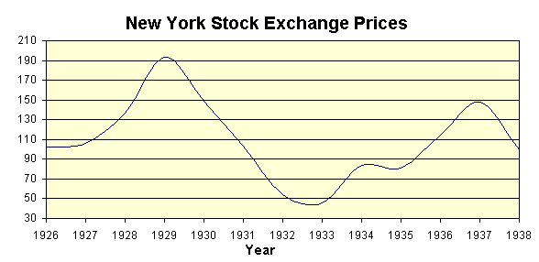
Reading Questions
Graph Questions
What was the Stock Market Crash of 1929
What were some of the events that led up to the stock market crash?
What happened after the stock market crash?
In what year were stock prices the highest?
In what year were prices the lowest?
Why do you think that this table shows the years from 1926 to 1938?
How does the stock market crash appear on the graph?
What was the effect of the stock market crash shown on the graph?

Slide 8
Picture Analysis
In your small group, analyze each of the images from the Great Depression and Dust Bowl. Each group member must fill out their own analysis pages. When you have looked through all of the images and completed the worksheet, answer the following questions on the back:
What is the overall mood of these images?
How do the images represent various groups of people (age, race, gender, occupation)? How might life have been different for members of each group?
Which image is the most impactful on you? Why?
In what ways do you think you would have personally coped with the conditions of the 1930s if you were living then?

Slide 9
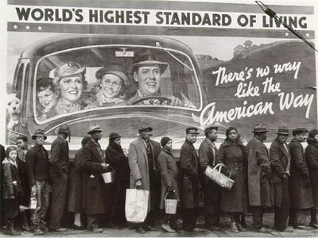

Slide 10
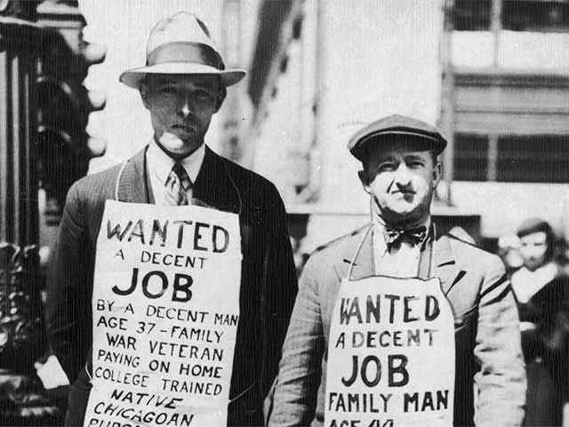

Slide 11
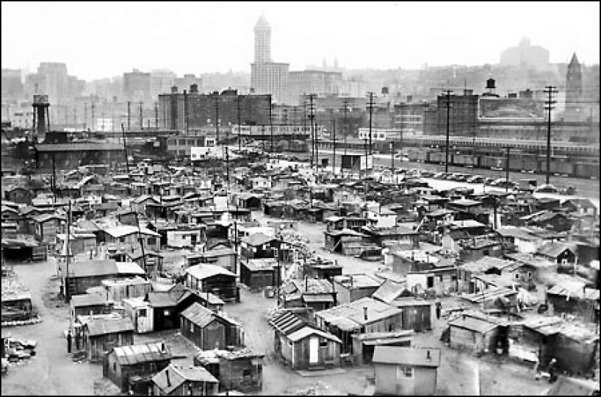

Slide 12
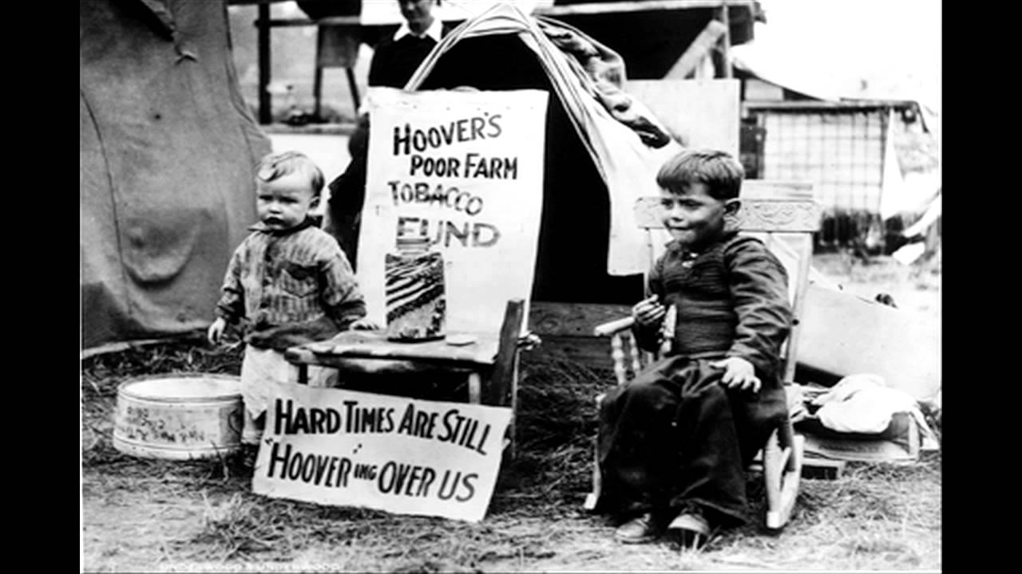

Slide 14
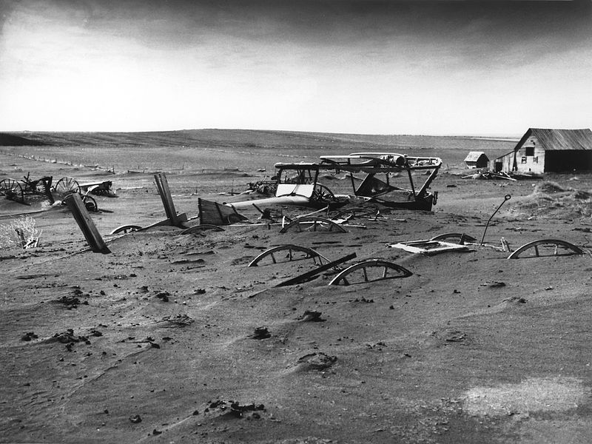

Slide 15
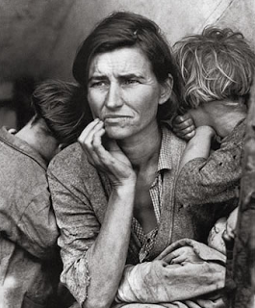

Slide 16
Do Now- 11/16
During the second half of the 1920s, which economic trend was a major cause of the Great Depression?
What effect did this trend have on the economy as a whole?

Slide 17
Goals- 11/16/15
Objective:
Assess how traditional nativist attitudes and immigration laws impact various groups of immigrants and the cultural development of the United States (e.g., Italians, Roman Catholics Immigration quota act of 1924)?
Essential Question:
How did the three “Rs” impact minorities and working-poor?

Slide 18
Agenda 11/16/15
Do Now
Pass back assignments/turn in late work
Finish Image Analysis
Close Reading- Three R’s
Weekly essay- Introduction

Slide 19
Do Now
Log onto a computer in the back row and go to masteryconnect.com
Wait for instructions on how to log in, this will be on your slip of paper

Slide 20
Do Now- 11/17
What do you understand well from this unit (1920s and 1930s)?
What do you not understand well from this unit?
TEST WEDNESDAY 11/18
https://play.kahoot.it/#/?quizId=3d037b13-db4e-4ced-ba00-051d19fb8b1b

Slide 21
Unit 4 Test- Written Response
Answer all of the following prompts in at least 5 sentences:
Explain the influence of consumerism on the U.S. in the 1920s.
What was the stock market crash of 1929 and how did it lead the United States into the Great Depression?
Discuss the conditions of the Great Depression and the government’s plan to get the U.S. out of it.

