Slide 1
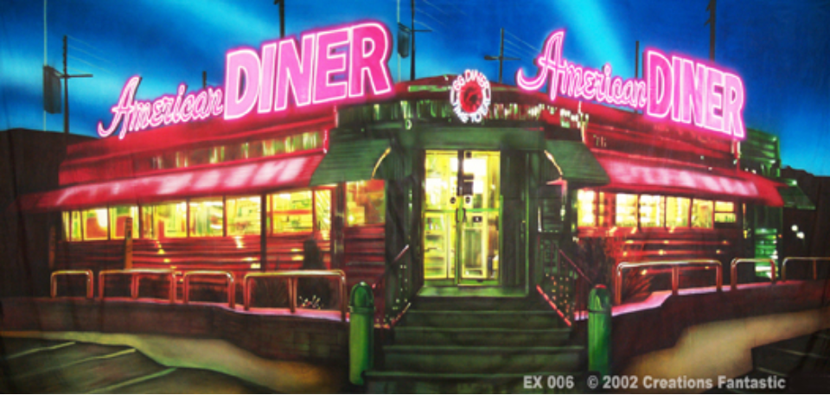
1950’s Popular Culture

Slide 2
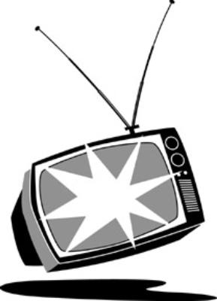
How did mass media change in the 1950s?
TV
Hours of viewership went up from 3.2 hrs./day to 7.7 hrs./day
TV Shows
I Love Lucy starring Lucille Ball and Desi Arnaz…TV’s first interracial couple
Bonanza
Western
Gunsmoke
Western
Leave it to Beaver
Idealized American family
The Twilight Zone
1st Sci-fi program

Slide 3
How did mass media change in the 1950s?
Drive-thru and cinemas pop up around the nation (avg. price for a show = $0.05)
Movies of the 1950s
Rebel without a Cause starring James Dean
The Ten Commandments starring Charlton Heston
Vertigo starring Jimmy Stewart
Invasion of the Body Snatchers starring Kevin McCarthy

Slide 4
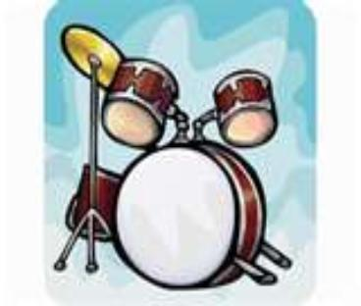
How did mass media change in the 1950s?
Music
The FCC (Federal Communications Commission) is created
Rock and Roll is born
Elvis Presley
The Four Tops
Buddy Holly & the Crickets
Little Richard
Chuck Berry

Slide 5
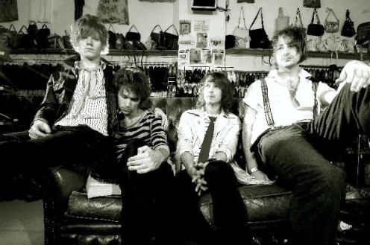
How did mass media change society?
The beat movement
The Beatniks
Earliest form of hippy communal lifestyle in America
Lived without material goods (including furniture & new clothing)
Grew long beards and grew their hair out and women wore NO make-up
Created the terms “bread” and “pad”

