Slide 1
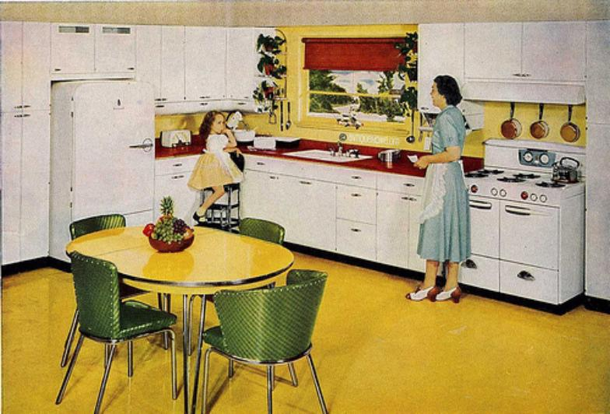
Life in the 1950s

Slide 2
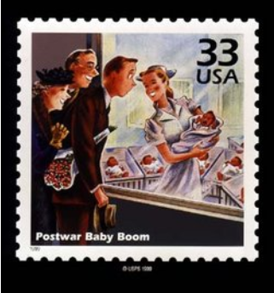
What changed in American society after WWII?
The Baby Boom
More children are born in the 1950s than any other decade
At its height there was a child born every 6.9 seconds
The main reasons behind this were…
Reunion of families after the war
Decreasing marriage age…down to about 21 for women and 23 for men
Advances in medicine
Desire for a large family
Economic Prosperity

Slide 3
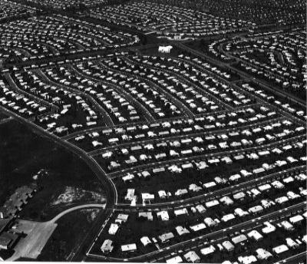
What changed in American society after WWII?
Rise of the suburbs
GIs (General Infantry) returning from war purchase homes outside of the urban cities
Sub-developments became popular and the idea for the “cookie cutter” home was born
Worked on the ideal image that the man worked and the woman raised the family

Slide 4
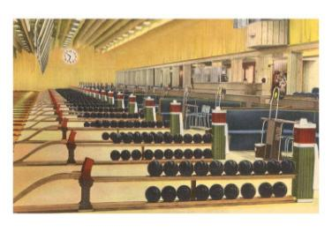
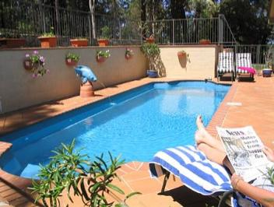
What changed in American society after WWII?
Leisure becomes important to those who survived the difficulties of the Great Depression and WWII
Peak of comic book production and sales
Little baseball reaches its zenith
Bowling alleys open in almost every city in America
Boy and Girl Scouts numbers reach all time highs
Swimming pools become popular at both homes and public locations

Slide 5
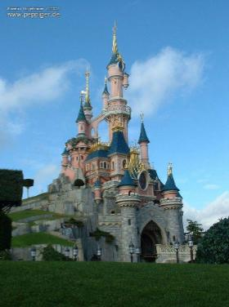
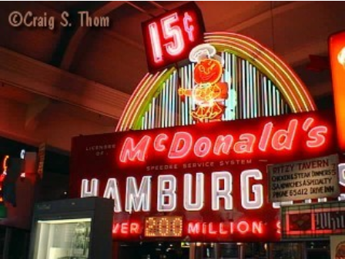
What changed in American society after WWII?
Business
Icons of the 50s
Franchises begin…McDonalds opened its first doors in Illinois in 1955
Disney Land opened in California in 1955

Slide 6
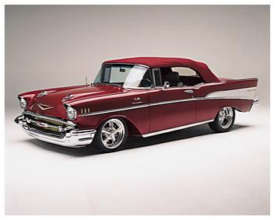
What changed in American society after WWII?
The automobile culture
Cruising…teenagers start to drive around and neck
Road trips
The drive-in…thousands of drive-in theaters open around the nation
The drive-thru…fast food restaurants served patrons on roller skates
The interstate highway system …over 60,000 miles of highway are constructed
Every interstate highway has a stretch every 7 miles that a plane could land on …incase of war or invasion

Slide 7
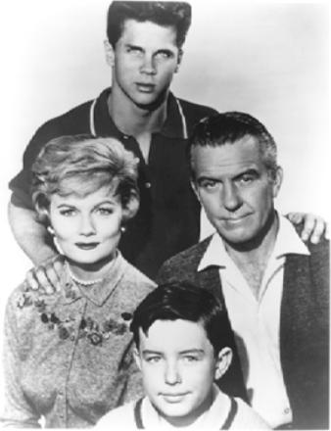
What did all of these changes to America?
Consumerism
The nation became much more consumer driven
This was the decade of the “American Dream”
A house, 2 cars, and a family of 4

Slide 8
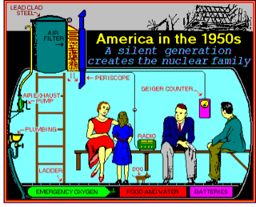
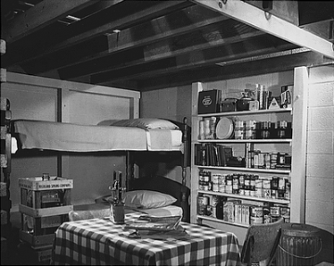
Life at Home worrying about Communism and a Nuclear Attack
1) Individuals build bomb shelters near their houses.

Slide 9
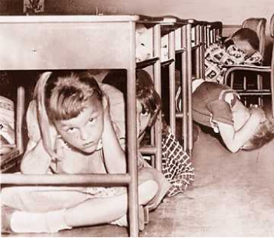
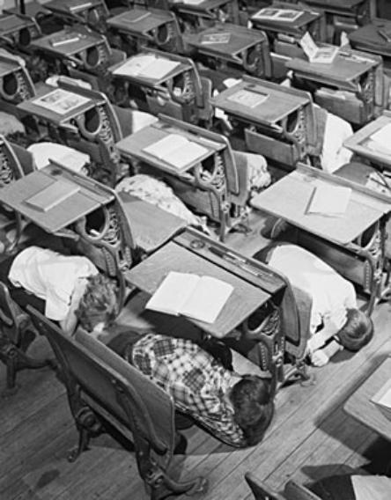
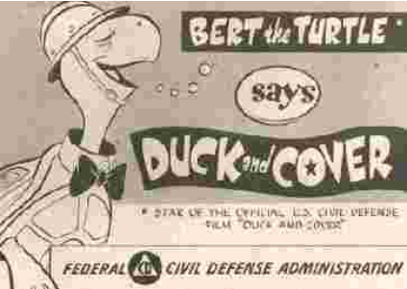
2) Schools and students prepare for a nuclear explosion with drills.

