Slide 1
Do Now- 12/1
When is it justified to restrict the rights and freedoms of American citizens? Explain and give examples if possible.

Slide 2
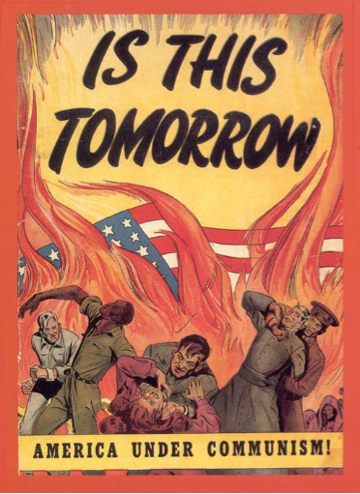
Cold War Conflict
Democracy vs. Communism

Slide 3
U.S and Soviet aims around the world
United States
Encourage democracy in other countries to help prevent the rise of new totalitarian governments.
Gain access to raw materials and markets for its booming industries.
Rebuild European governments to ensure stability and to create new markets for American goods.
Reunite Germany, believing that Europe would be more secure if Germany were productive and less bitter about defeat.
Soviet Union
Encourage Communism in other countries as part of the worldwide struggle between workers and the wealthy.
Transfer the industrial equipment of Eastern Europe to the Soviet Union to help rebuild its war-ravaged economy.
Control Eastern Europe to balance the US influence in Western Europe.
Keep Germany divided and weak

Slide 4
A Deadly Equation
Communism vs. Democracy (Capitalism)
+
Nuclear Weapons =
COLD WAR

Slide 5
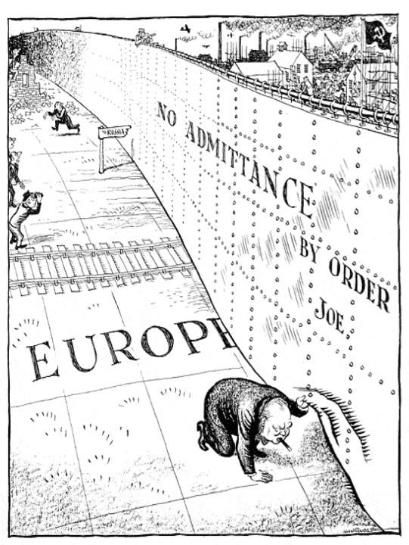
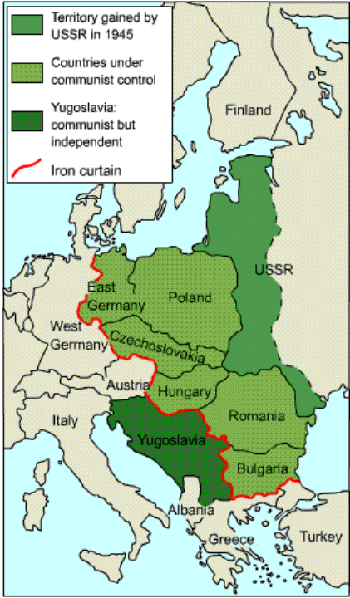

Slide 6
Cold War Terms to Know
Terms Associated with the Soviet Union
Satellite Nations – Countries dependent upon the Soviet
Union for all forms of existence.
Iron Curtain – Communist stronghold in Europe…a term
coined by Winston Churchill. (Separates democratic and
Communist Countries)
Warsaw Pact – Military alliance between the Soviet Union
and other Eastern European nations.

Slide 7
Cold War Terms to Know
Terms Associated with the United States
Containment – The U.S. policy of blocking or stopping the
spread of Communism. (Or democracy…Soviet Union)
Truman Doctrine – U.S. plan to support any nation or
government opposed to Communist rule.
Marshall Plan – U.S. plan to economically and industrially
rebuild Europe with U.S. funds.
NATO – Military alliance between the U.S. and other
non-Communist nations.

Slide 8
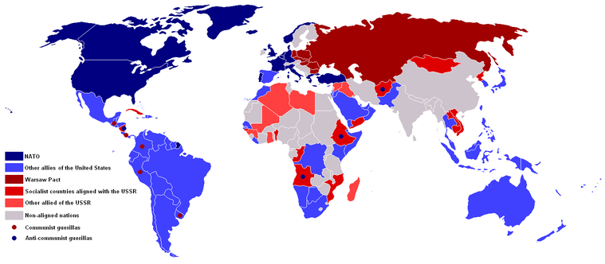
NATO vs. Warsaw Pact
NATO Countries:
Belgium, Canada, Denmark, France, Iceland, Italy, Luxembourg, the Netherlands, Norway, Portugal, United Kingdom and United States
Warsaw Pact Countries:
Soviet Union, Albania, Poland, Romania, Hungary, East Germany, Czechoslovakia, and Bulgaria

