Slide 1
Do Now- 10/9/15
Get your materials from the timeline out and begin to finish it. Your seats from yesterday are your new seats for the unit
You have a Question to answer and write in your Do Nows later on.

Slide 2
Announcements:
-Next week Monday we will have a district required benchmark test
-Midterms begin next Friday, 10/16 for 4th block, Monday, 10/19 for 3rd block, Wednesday, 10/21 for 1st block.

Slide 3
Do Now 10/12
In your opinion, what were the 2 most important events on your timeline in terms of influence on U.S. expansion?
What new technology allowed the United States to continue expanding successfully from the 18th century to the mid 20th century?

Slide 4
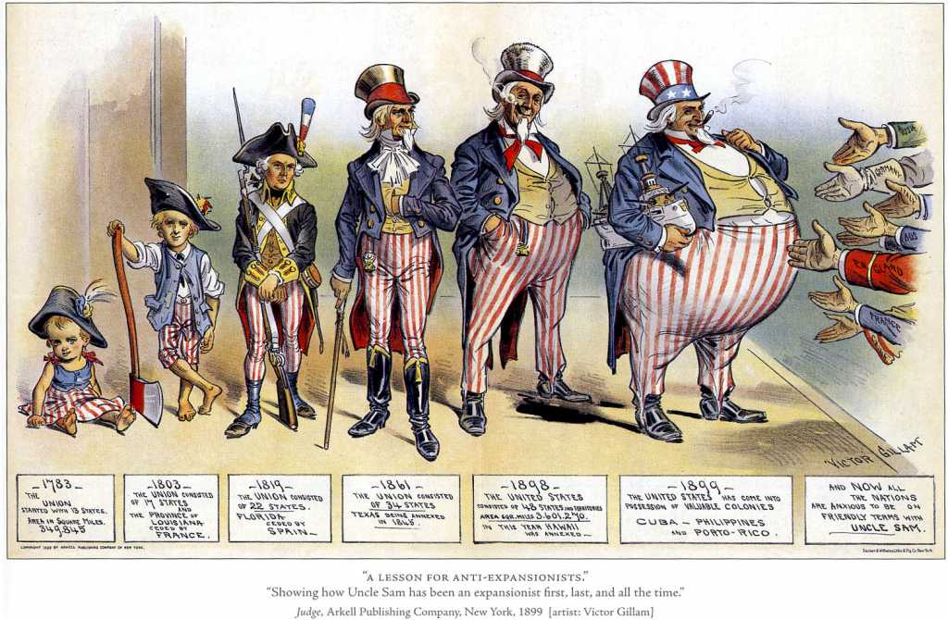

Slide 5
Chapter 18-1 Imperialism and America
Mr. Hammill
Phillip O Berry High School

Slide 6
Discussion Questions
(1) How did technological advancement lead to the United States’ increased involvement in world affairs?
(2) What new ideas influenced America’s desire to expand?

Slide 7
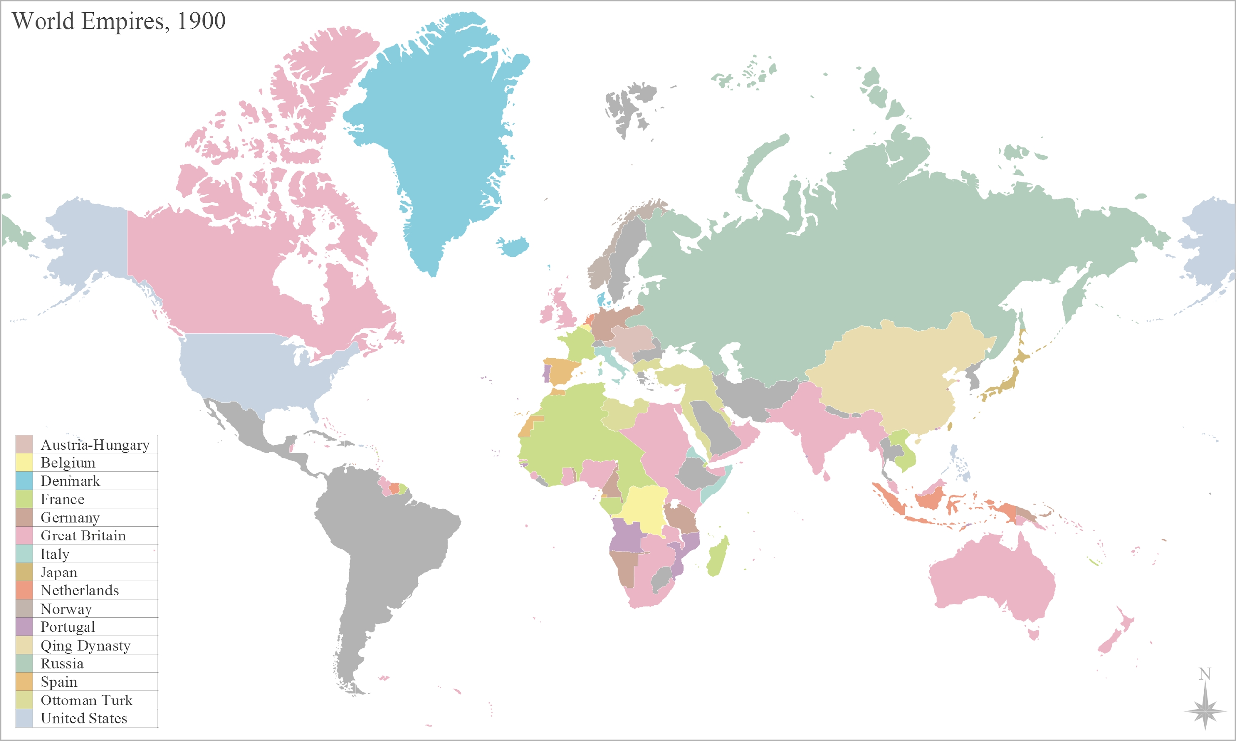
Do Now- 10/12 What is an Empire?
https://www.youtube.com/watch?v=uEx5G-GOS1k

Slide 8
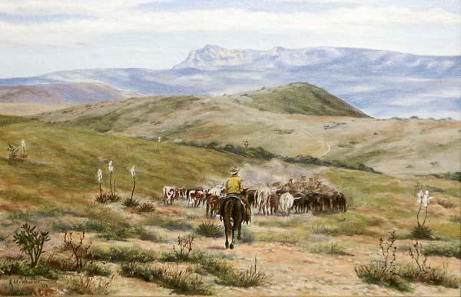
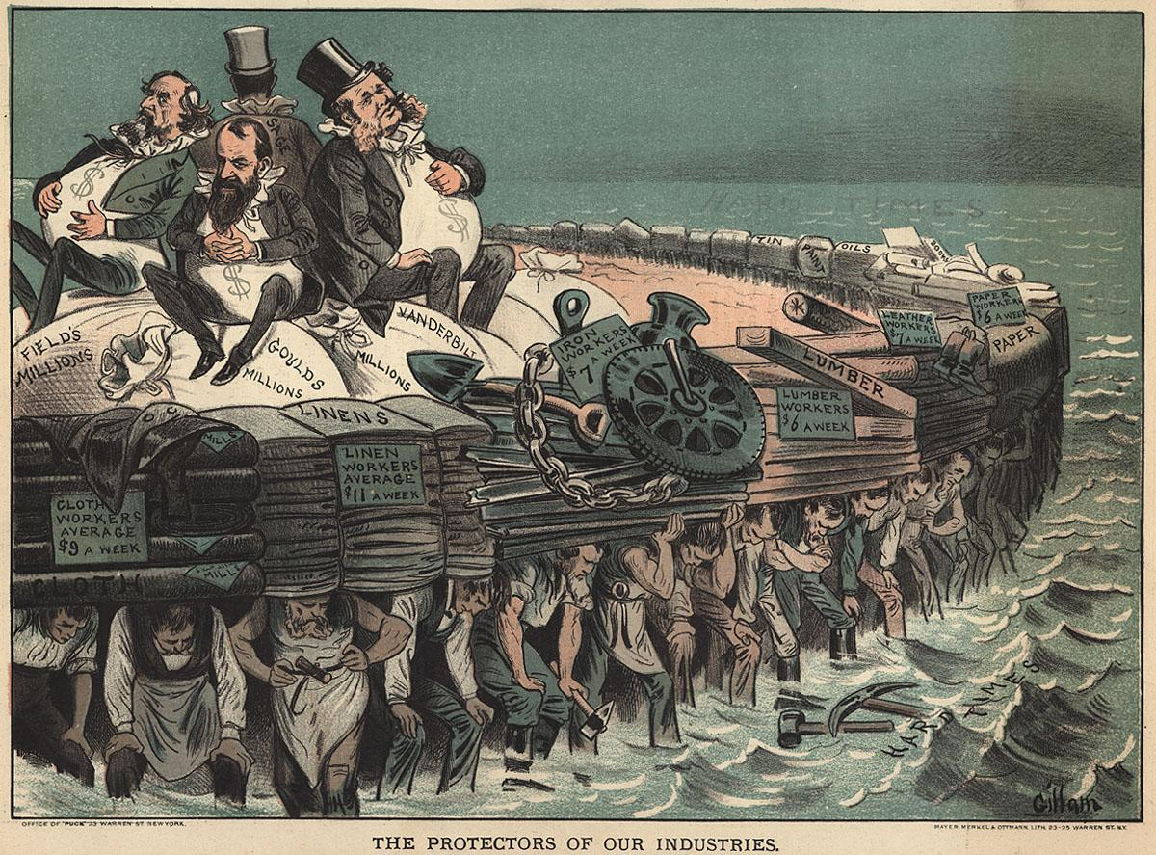
Background
After Civil War, Americans interested in
Reconstructing the South
Settling the West
Building up industry
Not wanting to expand

Slide 9
Change of Course
Opinion on expansion begins to shift in 1880s → Why?
- Desire to make U.S. a world power
Imperialism: Where a stronger
country forces their way of life
on a weaker country

Slide 10
Has the US done this already?
Monroe Doctrine
Manifest Destiny
Frederick Jackson Turner’s Thesis
US will expand beyond its borders to continue the frontier

Slide 11
Why did America join the imperialist club in the early 1900s? (3 Reasons)

Slide 12
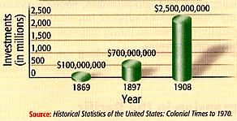
1. Thirst for New Markets
U. S. Foreign Investments: 1869-1908

Slide 13
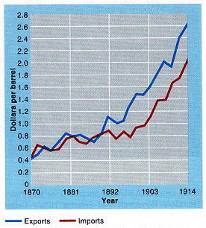
1. Thirst for New Markets
Need new trade partners to sell overflow of goods
Needed raw materials for factories
American Foreign Trade: 1870-1914

Slide 14
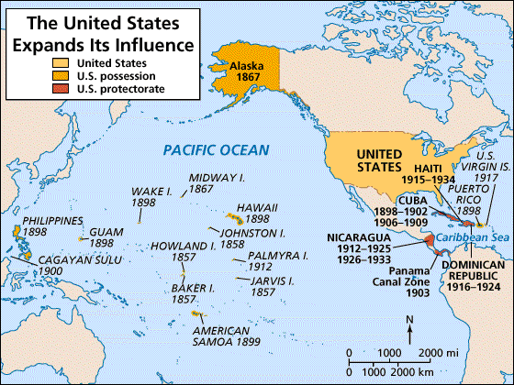
2. Desire for Military Strength
Alfred T. Mahan → The Influence of Sea Power on History: 1660-1783

Slide 15
2. Desire for Military Strength
Admiral AlfredT. Mahan
Wrote “The Influence of Sea Power on the World”
Argued that control of the sea was key to world dominance
US builds up Navy to get this control
World enters into a Naval Arms Race
Notes:
15
Other nations were increasing their global military strength and the U.S. needed to catch up
Read by the major world powers and helped stimulate the naval race
US built 9 steel-hulled cruisers between 1883-1890

Slide 16
USS Flagship Georgia

Slide 17
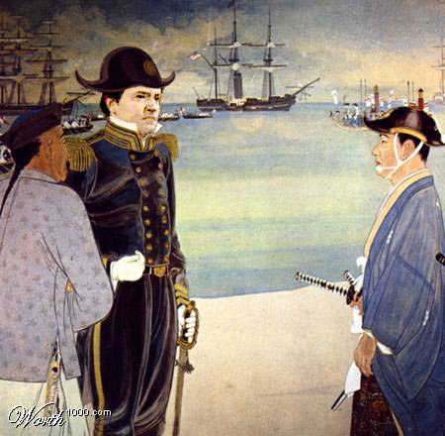
The Great White Fleet and Japan
US fleet (8 ships) sent out to show the US naval strength around the world
Commodore Matthew Perry brings US ships into Japan
Japan had been closed to all foreigners
Perry threatened Japan to open trade with US
Japan worked out a deal to open trade to the United States

Slide 18
3. Cultural Superiority
Social Darwinism
- Survival of the fittest
US needed to “civilize” the inferior people of the world
(Seen as part of
Manifest Destiny)

Slide 19
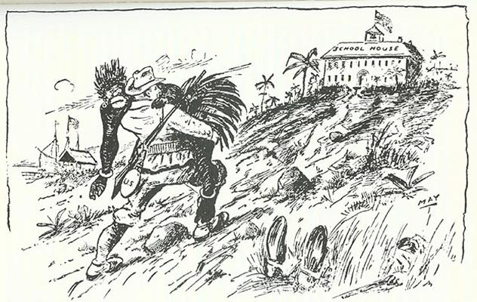
3. Cultural Superiority
The White Man’s Burden
(Responsibility)
-Rudyard Kipling
The Hierarchy of Race

Slide 20
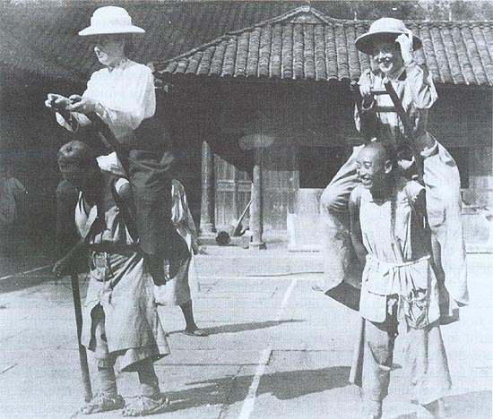
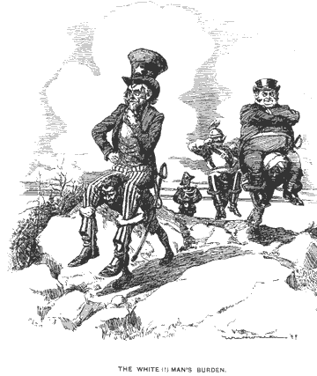
Religious/Missionary Interests
American Missionaries in China, 1905

Slide 21
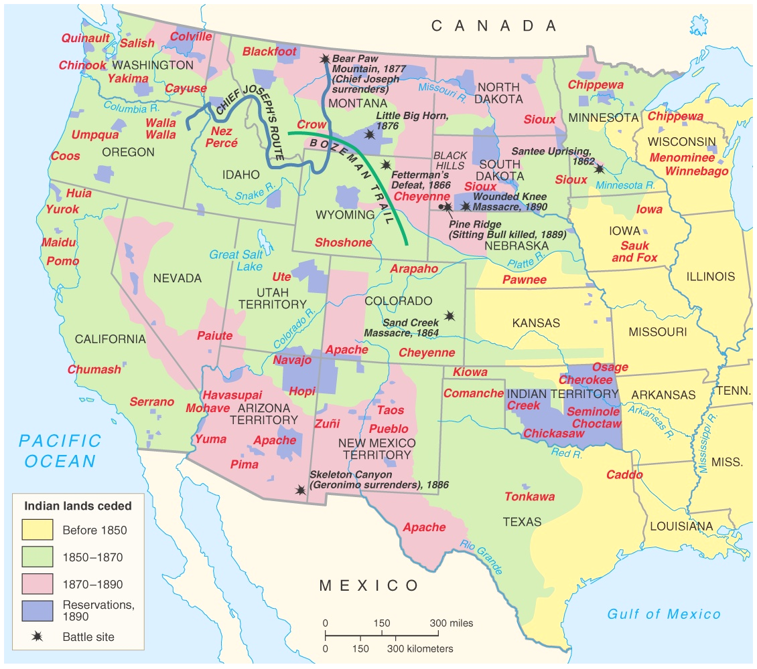
Closing the American Frontier
(Frederick Jackson Turner → America will need a wider field of influence)

Slide 22
(1) How did technological advancement lead to the United States’ increased involvement in world affairs?
(2) What new ideas influenced America’s desire to expand?

Slide 23
Hawaii: “Crossroads of the Pacific”

Slide 24
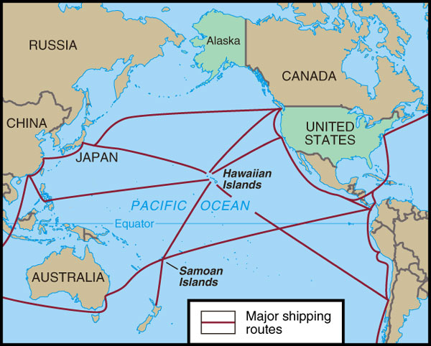
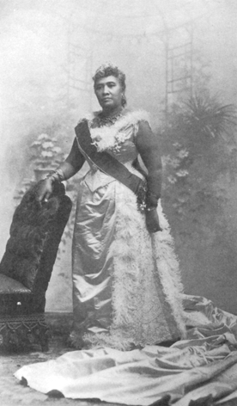
Hawaiian Queen Liliuokalani
- Hawaii for the Hawaiians!

Slide 25
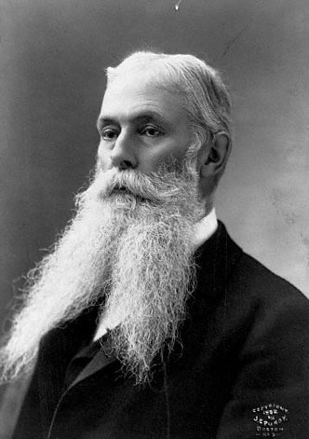
U. S. Business Interests In Hawaii
1875 – Reciprocity Treaty
(Hawaiian sugar – tax free)
1890 – McKinley Tariff
(tax on imported sugar)
1893 – American businessmen backed an uprising against Queen Liliuokalani.
Sanford Ballard Dole proclaims the Republic of Hawaii in 1894.

Slide 26
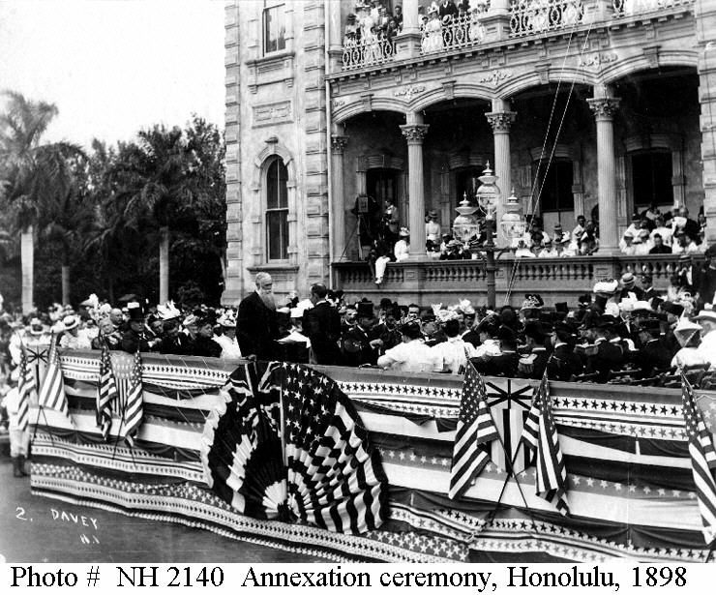
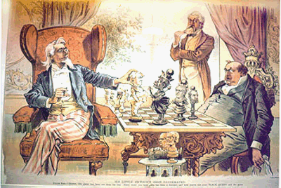
To The Victor Belongs the Spoils
- Hawaiian Annexation Ceremony, 1898

Slide 27
Alaska

Slide 28
Acquiring “Seward’s Icebox”
- 1867: Secretary of State William Seward bought Alaska from Russia for $7.2 million (.02/acre)
- People thought this was a bad deal and called it “Seward’s Folly”
Notes:
28
William Seward arranged for U.S. to buy
House of Representatives gave him a hard time to approve funds for the purchase
Great deal: 2 cents an acre got a land rich in timber, minerals and OIL

Slide 29
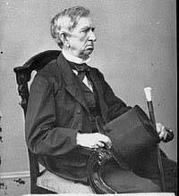
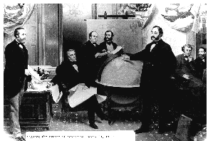
“Seward’s Folly”: 1867
$7.2 million

Slide 30
“Seward’s Folly”: 1867
Many critics believed Seward’s purchase of Alaska was a useless mistake
Until gold was discovered in the Yukon and Alaska become the gateway to major gold deposits

Slide 31
American Territories- 2015
Puerto Rico- 3,548,397 (29th)
Guam-159,358 (53)
U.S. Virgin Islands-106,405 (54)
Northern Mariana Islands- 53,883 (55)
American Samoa- 55,519 (56)
https://www.youtube.com/watch?v=CesHr99ezWE

