Slide 1
Do Now- 10/8/15
Find someone you have never sat with in class before and find a place to sit next to them at a different table than you sat at before.
Ask your partner what his/her favorite movie or TV show is and what they like best about it. WRITE THIS PART ON YOUR DO NOW SHEET.

Slide 2
American Imperialism
The United States as a World Power

Slide 3
Today’s Goals
Objective:
Trace the United States’ expansion from the first colonies to territorial acquisition and imperialism around the world by creating a cohesive timeline of events and descriptions.
Essential Question:
a. How did technological advancement lead to the United States’ increased involvement in world affairs?
b. What new ideas influenced America’s desire to expand?

Slide 4
American Imperialism
What is imperialism?

Slide 5
American Imperialism
What is imperialism?
Imperialism is the policy of extending a country’s power beyond its borders through diplomacy or force.
Do you know any examples of an imperial country or empire from previous classes?

Slide 6
U.S. Expansion Timeline
For this activity you will be working with your partner from today’s Do Now.
The goal of this activity is to work with your partner to create a cohesive timeline that shows the development of American expansion from colonization to imperialism.
You will match pictures with titles of events with their description and tape them to your timeline in chronological order.
You may use the technology support station as a resource to help you make your matches after answering a question correctly.

Slide 7
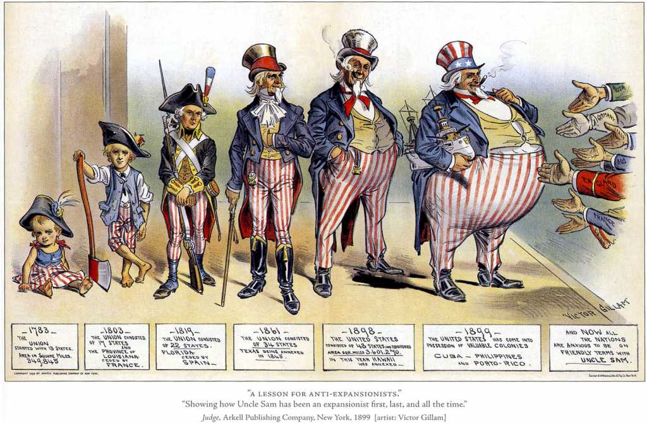

Slide 8
Exit Ticket
In your opinion, what were the 2 most important events on your timeline in terms of influence on U.S. expansion?
What new technology allowed the United States to continue expanding successfully from the 18th century to the mid 20th century?

