Slide 1
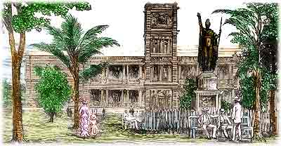
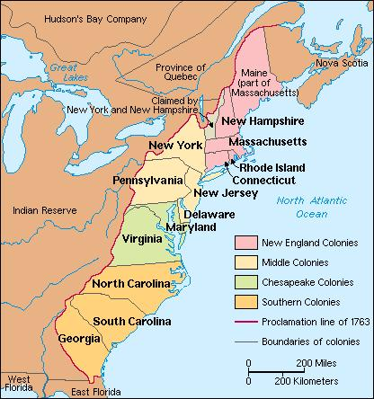
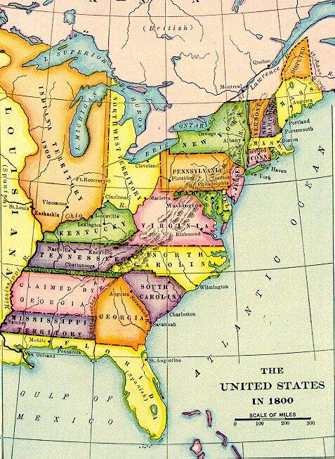
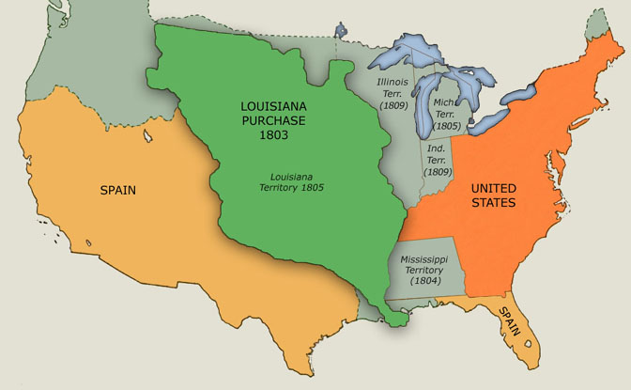
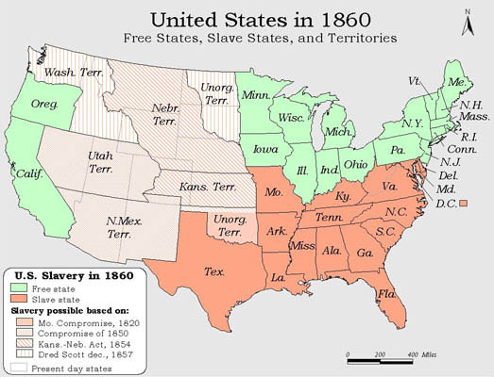
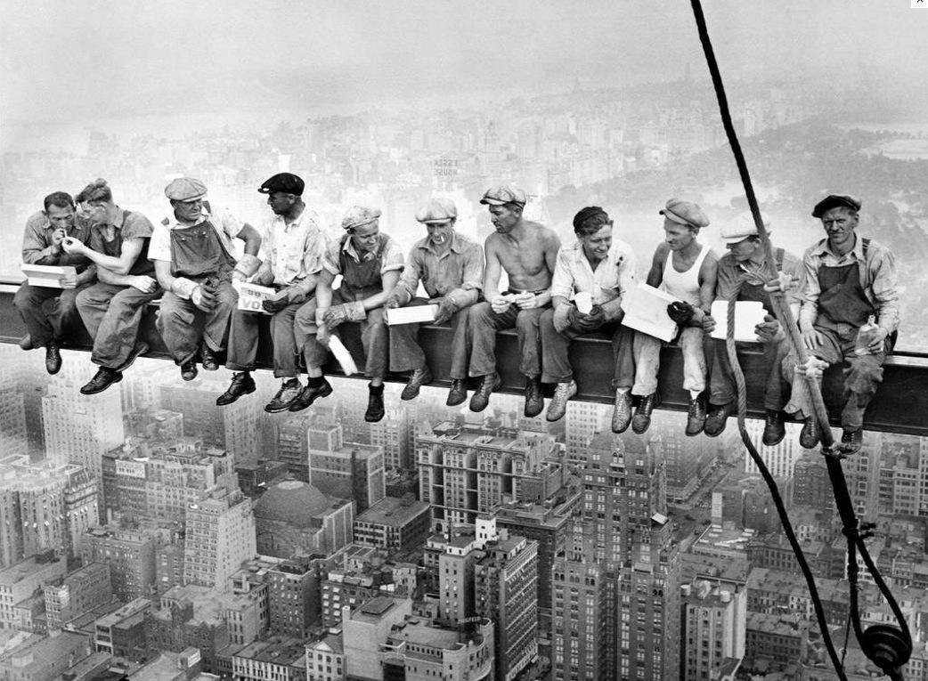
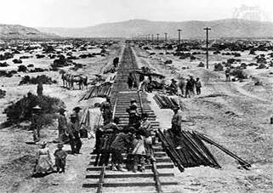
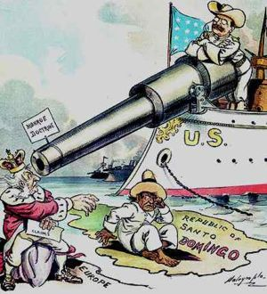
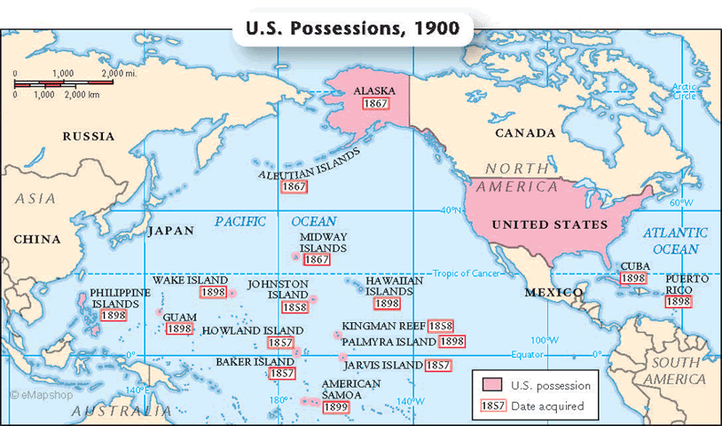
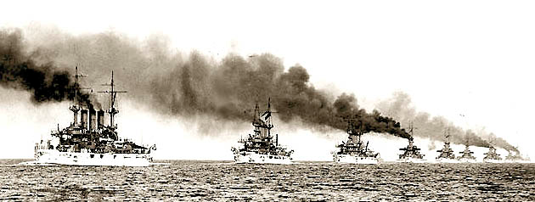
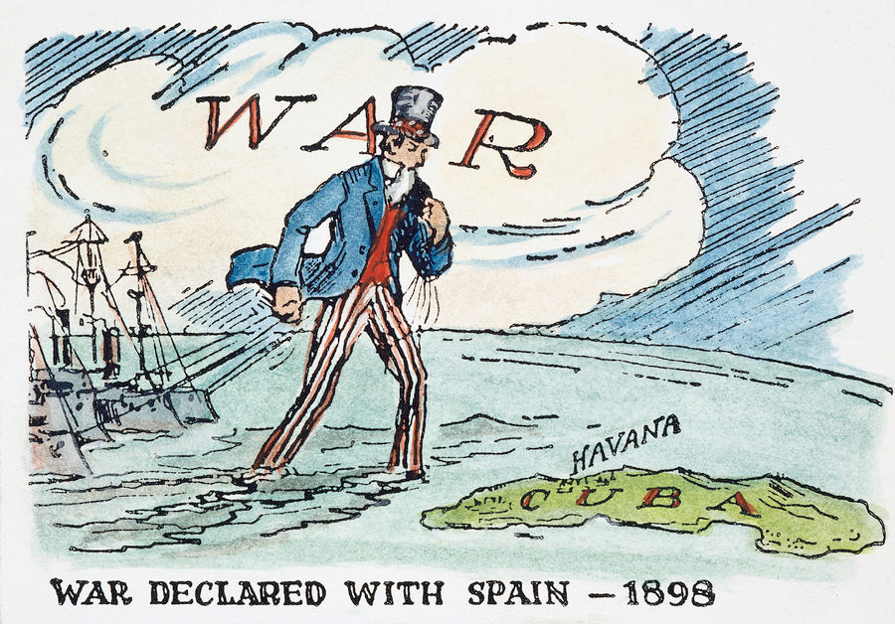
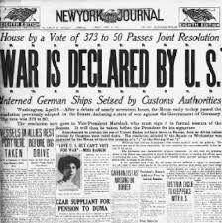
Thirteen Colonies- 1776
Treaty of Paris- 1783
Louisiana Purchase- 1803
Hawaiian Annexation- 1898
United States- 1860
Growth of U.S. cities
Building the Transcontinental Railroad
Roosevelt Corollary- 1904
Spanish American War- 1898
U.S. and Possessions- 1900
America’s Great White Fleet circles the globe- 1907-1909
U.S. enters World War I- 1917

Slide 2
The United States was looking to expand beyond its borders and this kingdom was strategically located in the Pacific Ocean. A military presence here would allow the U.S. to establish dominance in the region. | First settlements in the United States that eventually gained independence. This was the first step in American expansion since it led to a self-governing nation. | Great Britain ceded control of the Ohio River Valley to the United States. This region offered generous amounts of resources and trade routes that were essential to a growing economy. | Americans were looking for a way to reach the Pacific Ocean by water route while this was being explored. Although it was discovered that the route did not exist, the exploration was considered successful.
After a series of both conflict and compromise, the United States fulfilled its goal of Manifest Destiny. Tension from the growth grew into conflict as sectionalism in the United States tore the country apart. | After the United States controlled the land from east coast to west coast, it continued to expand in another direction. New technology allowed for radical advancements in the way people lived. | New technology allowed for people to migrate across formerly uninhabited lands. Many families moved to work on farms given to them by the government. | Revolutions against European powers in Latin America called for the United States to get involved through diplomatic action. The United States felt it was important to show their strength through diplomacy before conflict.
Interference with the affairs of island nation’s caused tension across the globe. European powers and the United States both had political reasons to establish themselves in Latin America and the Caribbean. | At this time the United States had established itself as one of the world’s imperial nations. Most of the undeveloped world was being carved up by Europe so the United States continued its westward expansion beyond its western border. | This event showed off the growing strength of the United States and its new role in the world. President Roosevelt hoped this would enforce treaties and protect assets overseas. | As European nations fought across the Atlantic Ocean, the United States stayed neutral until it was forced to get involved. It wasn’t until an American passenger ship was sunk by German submarines and the threat of Mexico getting involved that the U.S. decided to join.

