Slide 1
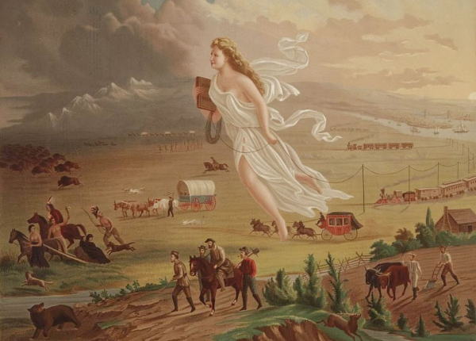
Directions: Address the significance of each piece of this picture.
Important!!! Number 1 – 6. Write a paragraph (3 sentences) for each.
6
1
5
2
4
3

