Slide 1
Do Now-9/30
In what ways do non-government entities (companies, individuals) influence legislation and policies?

Slide 2
Announcements
From now on, you will need a notebook for this class.
You need a notebook by this upcoming Monday, October 5.
If there is no way for you to get a notebook on your own, see me for help.
I will not be providing any paper

Slide 3
Daily Goals
Objectives:
· Analyze how urban political machines gained power and how they played a role in political corruption.
Essential Question:
How did Progressives and others address the problems of industrial capitalism, urbanization, and political corruption at the national, state and local levels?

Slide 4
Problems Lead to Political Machines
Problem: Cities grow so fast their gov’t (municipal) can’t keep up with needs of people
Solution: Political Machine steps in and provides services in exchange for votes and money
Goal of Pol. Mach: work to get their candidates elected
Transit, water & sewage systems, sanitation, protection

Slide 5
The Political Machine
City governments
Didn’t provide: jobs, financial aid, protection, sanitation etc.
Political Machine steps in
Cities
Provided services and business help in exchange for votes and money
Gangs of New York Election Day

Slide 6
Gangs of New York Elections
Based on what you saw in the video, what are a few ways that political elections (in this case, sheriff) were corrupt?
Give specific examples

Slide 7
Political Machines:
organized group that controlled things for a political party
All work together
To elect their
Candidates &
Ensure the success
Of the machine
city boss
ward bosses
precinct captains
precinct workers

Slide 8
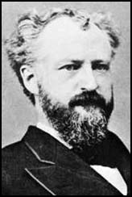
The City Boss: top man in a political machine
Got votes & $ for political party in return for providing services or favors
Controlled city jobs, business licenses, influenced the courts
Roscoe Conkling - boss of the NY Republican pol. mach.

Slide 9
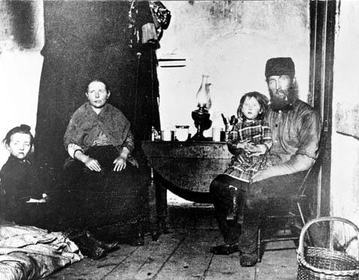
Immigrants and the Political Machine
- Constituents (voters) are often immigrants
- Bosses and precinct captains often 1st or 2nd generation immigrants themselves
Knew the language, culture, and what was needed
Immigrants taken
advantage of

Slide 10
Corruption in the Machines
Fraud: cheating to win elections
ex: voting more than once
Graft: using political influence for personal gain
ex: Bribes - businesses offered money to get city contracts

Slide 11
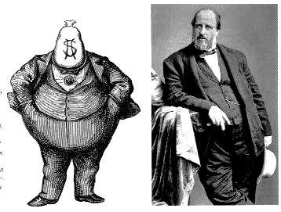
“Boss Tweed”
* William M. Tweed was City Boss of Tammany Hall, the Democratic Pol. Mach. in NY
Led ring of corrupt politicians who defrauded New York City 1869-1871
Boss Tweed

Slide 12
Gangs of New York- Political Machine
2. How were immigrants approached, used and exploited by political machines?

Slide 13
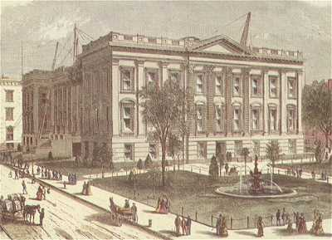
Tammany’s Corruption:
One example: the courthouse scam
Charged taxpayers $13,000,000 for project that cost $3,000,000
Estimated Tweed stole from $30 million to $300 million
Eventually indicted on (charged with) 120 counts of fraud and extortion

Slide 14
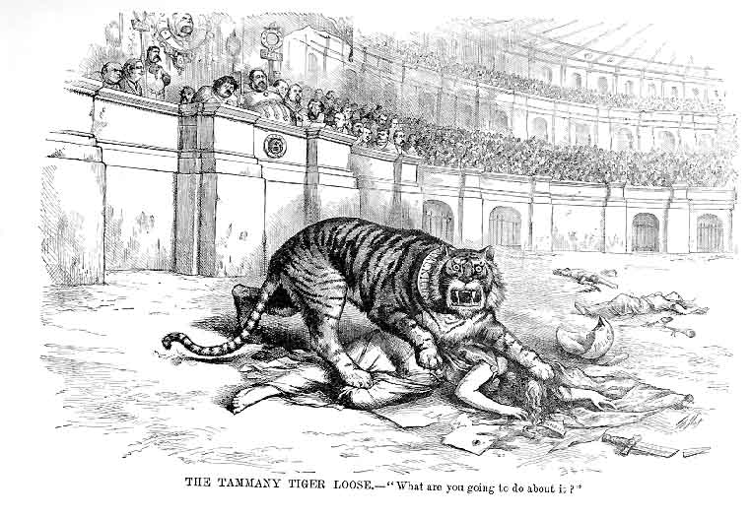

Slide 15
Cartoon Analysis
What does the Tiger represent?
What do the people on the ground represent?
What do the spectators represent?
What is the overall message of this cartoon?

Slide 16
The “Spoils” System (or patronage) in Politics
The winning party in an election got to hand out these jobs to their supporters
Government jobs were the “spoils”
This system is replaced with civil service
Jobs for the Homies?! Hmm… this reminds me of…
Andrew Jackson!

Slide 17
Civil Service
a system by which the most qualified people are hired for gov’t jobs
system based on candidates’ performances on an examination (& interview?)
Which system do you think is the most beneficial to the community it represents?

Slide 18
Urbanization
Influx of immigrants & migrants causes a population boom in cities
City services (housing, H2O, sanitation) are stretched to the limit
Reformers try to fix urban problems through ed., training, charity, and political action
Immigration & Migration
Poverty & persecution cause millions of people to leave Europe, China, Japan, Mexico for the U.S.
Immigrants forced to adapt to new language & culture
Changes in agri. cause pple. to migrate from rural U.S. to urban U.S.
Many immigrants and migrants face discrimination in jobs & housing
Politics
Pol. Mach. Develop to take advantage of the needs of immigrants & urban poor
City politicians use graft & fraud to maintain political power
Corruption in politics causes civil service system to be developed

Slide 19
Exit Question
What specific ways were political machines able to influence politics during the Gilded Age?
What impact did this have on the community?

