Slide 1
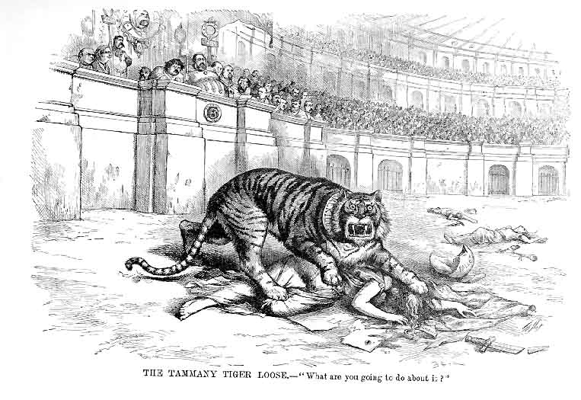
Do Now-10/1/15
What is the overall message of this political cartoon?

Slide 2
Announcements
Unit 2 test will be Tuesday, October 6.

Slide 3
Daily Goals
Objective:
Explain progressive reforms to expand democracy at the local and state levels and evaluate their effectiveness
Essential Question:
a. What areas did Progressives think were in need of reform?
b. What did reformers want from the government?

Slide 4
The Progressive Era
1890-1920

Slide 5
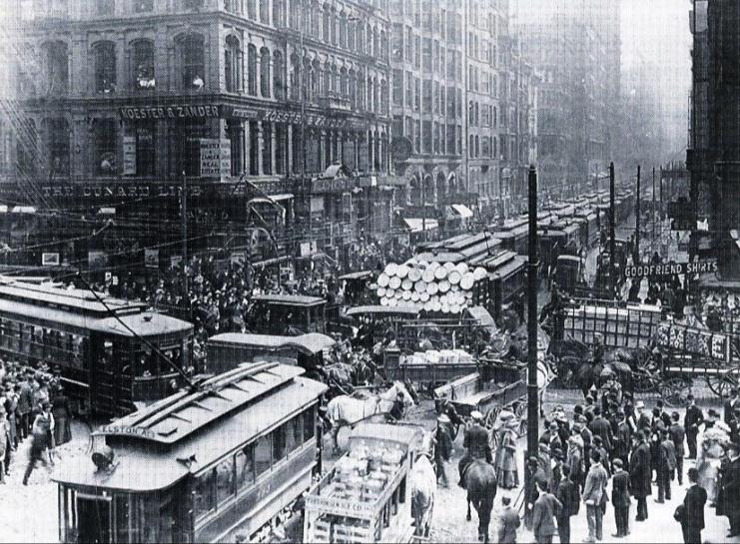
The United States entered the Progressive Era from 1890 to 1920 when a variety of reformers tried to clean up problems created during the Gilded Age
What problems existed in the Gilded Age?

Slide 6
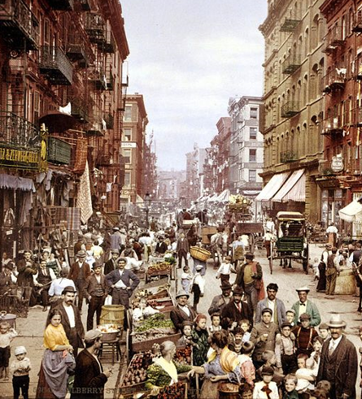
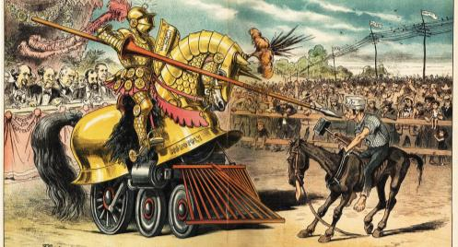
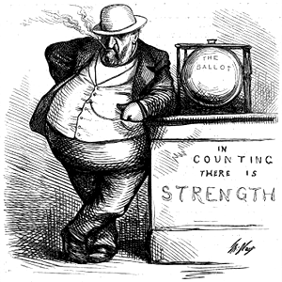
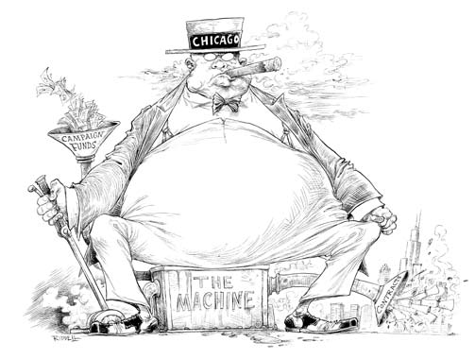
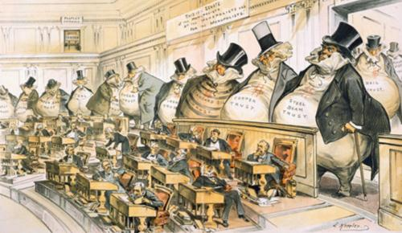
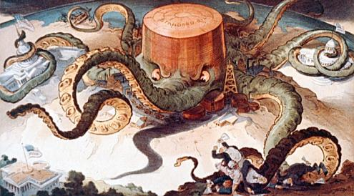
The United States entered the Progressive Era from 1890 to 1920 when a variety of reformers tried to clean up problems created during the Gilded Age
Industrialization led to a rise in urbanization, immigration, poverty, and dangerous working conditions
City, state, and federal governments were seen as corrupt
Corporate monopolies limited competition and workers’ wages

Slide 7
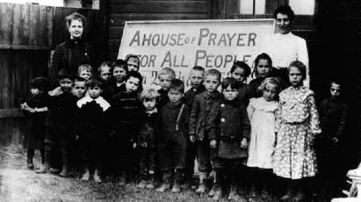
In the 1880s, many middle-class Protestant Christians embraced the Social Gospel movement
The Social Gospel taught that to honor God, people must help others and reform society

Slide 8
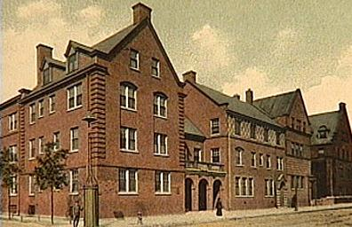
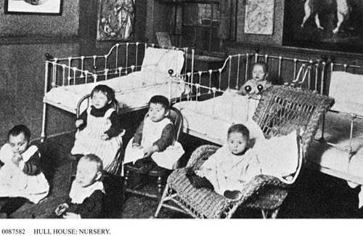
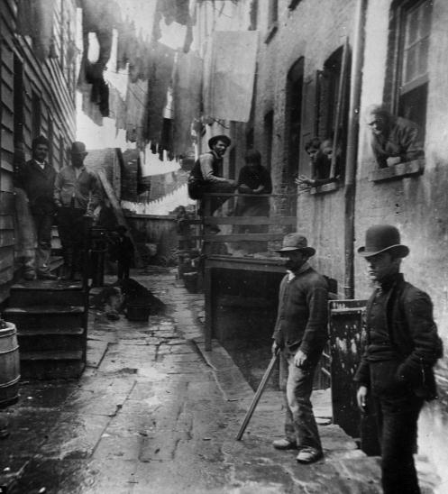
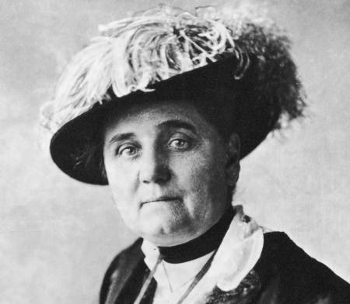
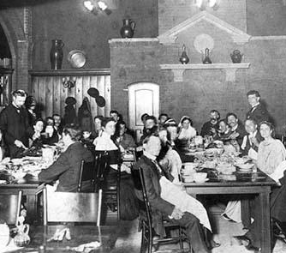
Progressive reform began in American cities in response to slums, tenements, child labor, alcohol abuse, prostitution, and political corruption
An early reformer was Jane Addams who created Hull House in Chicago
Hull House was the first settlement house which offered baths, cheap food, child care, job training, health care to help the poor
Jane Addams’ efforts inspired reformers in other cities to build settlement houses to assist the poor

Slide 9
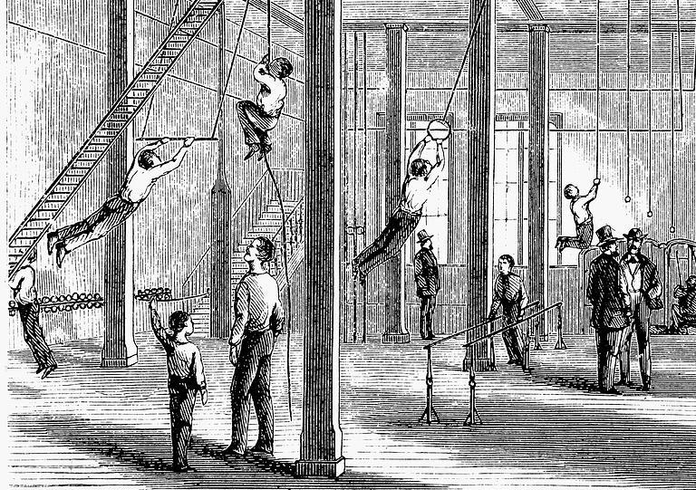
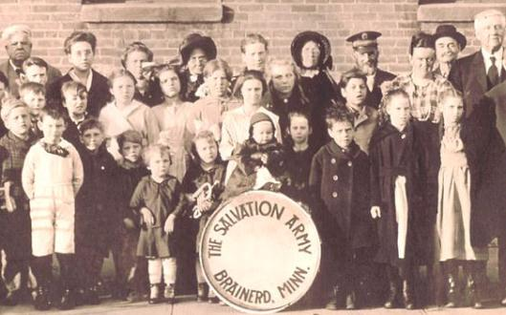
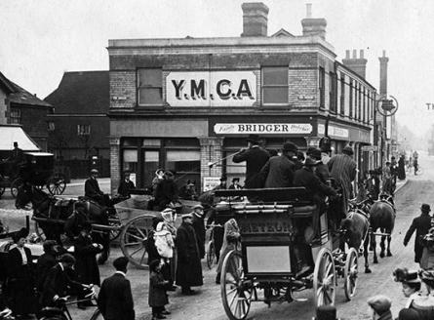
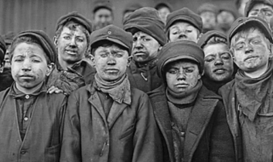
Urban reformers tried to improve the lives of poor workers and children
The YMCA created gyms and libraries to help young men and children
The Salvation Army created nurseries and soup kitchens
Florence Kelley fought to create child labor laws and laws limiting women to a 10 hour day

Slide 10
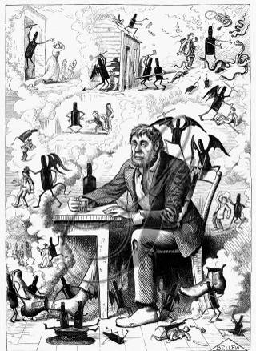
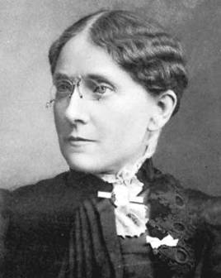
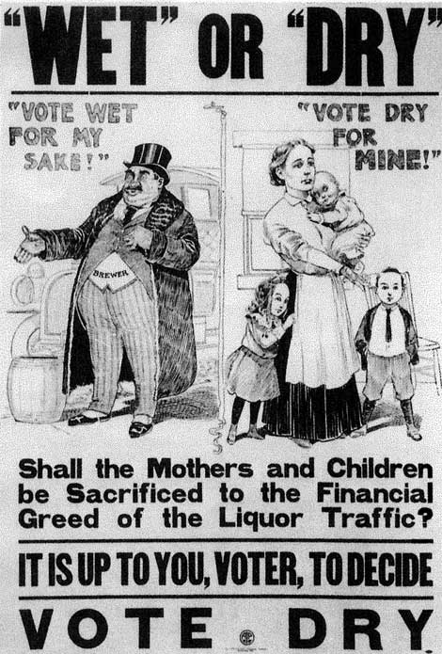
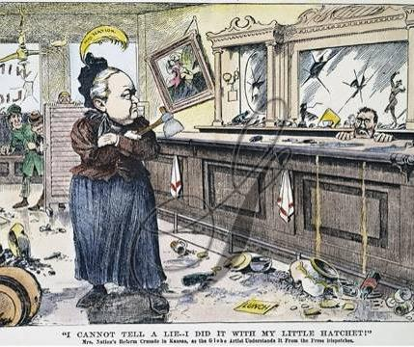
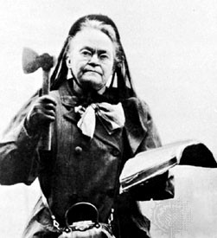
Many reformers saw alcohol abuse as serious problem
Frances Willard
Temperance reformers hoped that ending alcohol would reduce corruption, crime, assimilate immigrants
Reformers Frances Willard and Carrie Nation led the Women’s Christian Temperance Union (WCTU) to fight for prohibition laws
Carrie Nation

Slide 11
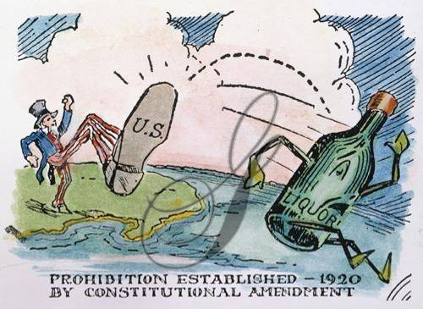
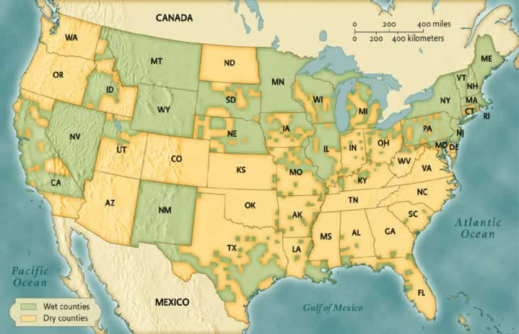
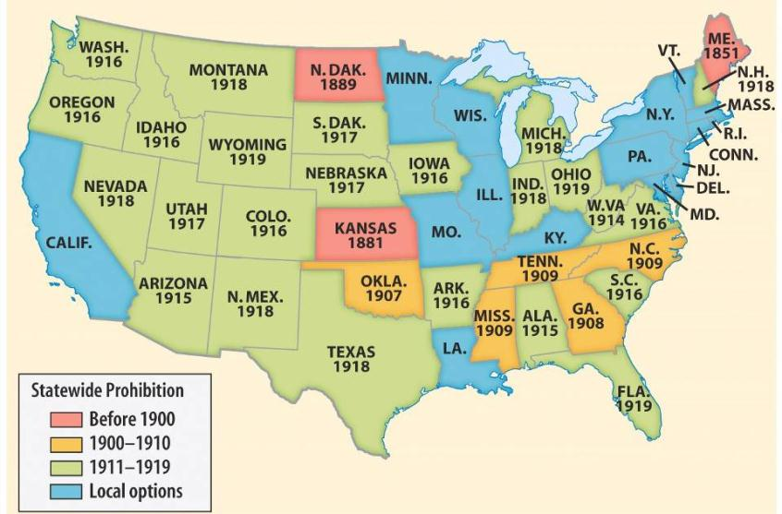
Reformers gained prohibition laws in rural areas and states in the South and West
In 1919, the states ratified the 18th Amendment which outlawed alcohol throughout the USA

Slide 12
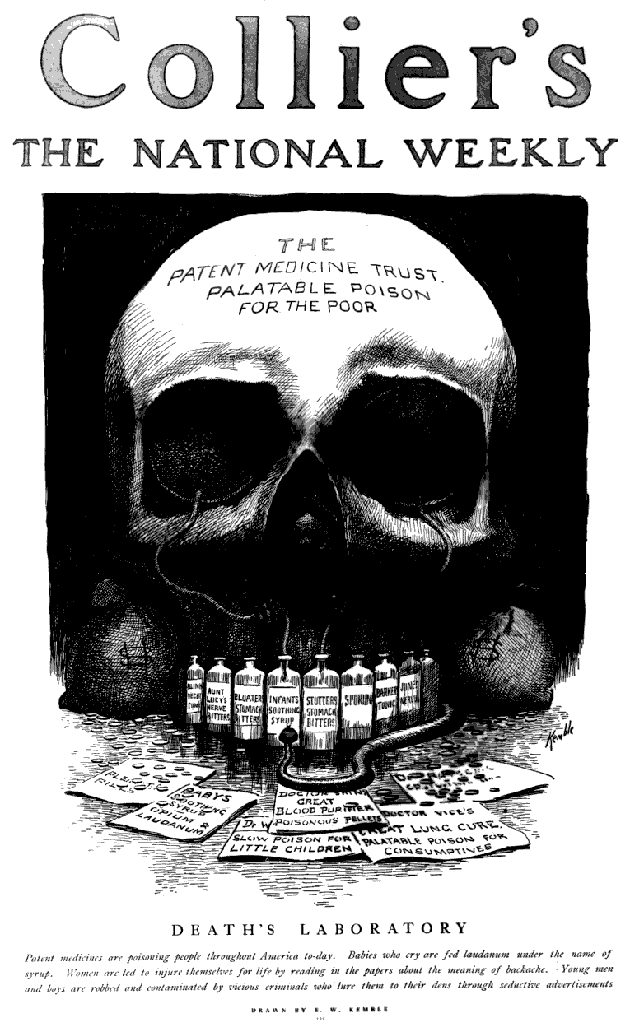
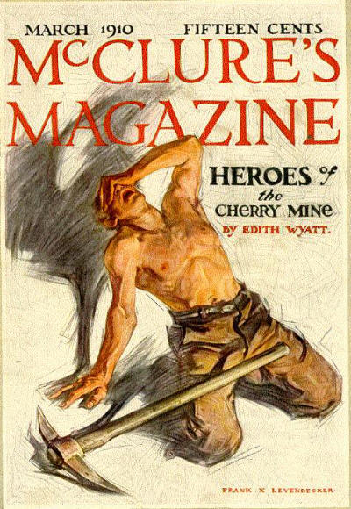
Investigative journalists known as muckrakers exposed corruption, poverty, health hazards, and monopolies

Slide 13
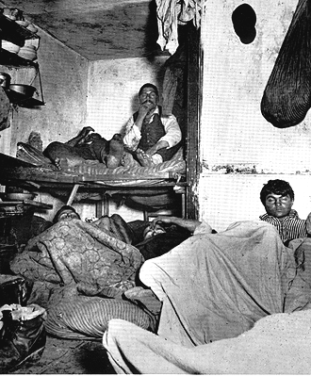
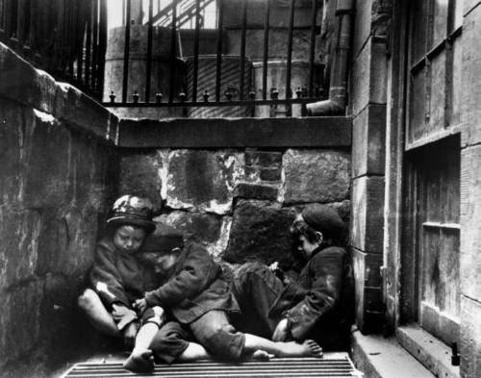
What did Jacob Riis’ How the Other Half Lives (1890) expose?
Jacob Riis’ How the Other Half Lives (1890) exposed urban poverty and life in the slums
http://www.history.com/topics/new-york-city/videos/jacob-riis
Notes:
http://www.history.com/shows/america-the-story-of-us/videos/playlists/exclusive-video#jacob-riis

Slide 14
Jacob Riis
What affects did Riis’ photographs have on the American public?

Slide 15
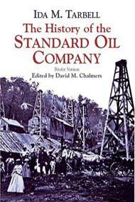
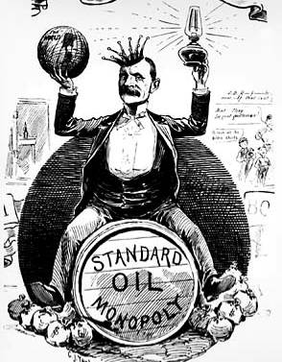
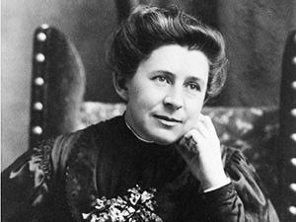
What did Ida Tarbell’s The History of Standard Oil (1904) expose?
Ida Tarbell’s The History of Standard Oil (1904) revealed Rockefeller’s ruthless business practices and called for the break-up of large monopolies

Slide 16
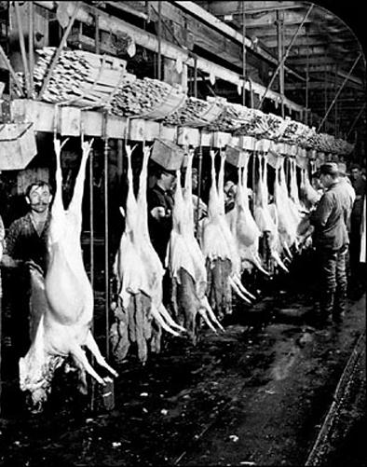
What did Upton Sinclair’s The Jungle (1906) expose?
Upton Sinclair’s The Jungle (1906) revealed the unsanitary conditions of slaughterhouses and led to government regulation of food industries

Slide 17
The Jungle Excerpt
Cut up by the two-thousand-revolutions- a-minute flyers, and mixed with half a ton of other meat, no odor that ever was in a ham could make any difference. There was never the least attention paid to what was cut up for sausage; there would come all the way back from Europe old sausage that had been rejected, and that was moldy and white – it would be dosed with borax and glycerin, and dumped into the hoppers, and made over again for home consumption. There would be meat that had tumbled out on the floor, in the dirt and sawdust, where the workers had tramped and spit uncounted billions of consumption germs. There would be meat stored in great piles in rooms; and the water from leaky roofs would drip over it, and thousands of rats would race about on it. It was too dark in these storage places to see well, but a man could run his hand over these piles of meat and sweep off handfuls of the dried dung of rats. These rats were nuisances, and the packers would put poisoned bread out for them; they would die, and then rats, bread, and meat would go into the hoppers together. This is no fairy story and no joke; the meat would be shoveled into carts, and the man who did the shoveling would not trouble to lift out a rat even when he saw one – there were things that went into the sausage in comparison with which a poisoned rat was a tidbit. There was no place for the men to wash their hands before they ate their dinner, and so they made a practice of washing them in the water that was to be ladled into the sausage. There were the butt-ends of smoked meat, and the scraps of corned beef, and all the odds and ends of the waste of the plants, that would be dumped into old barrels in the cellar and left there. Under the system of rigid economy which the packers enforced, there were some jobs that it only paid to do once in a long time, and among these was the cleaning out of the waste barrels. Every spring they did it; and in the barrels would be dirt and rust and old nails and stale water – and cartload after cartload of it would be taken up and dumped into the hoppers with fresh meat, and sent out to the public's breakfast. Some of it they would make into "smoked" sausage – but as the smoking took time, and was therefore expensive, they would call upon their chemistry department, and preserve it with borax and color it with gelatin to make it brown. All of their sausage came out of the same bowl, but when they came to wrap it they would stamp some of it "special," and for this they would charge two cents more a pound.

Slide 18
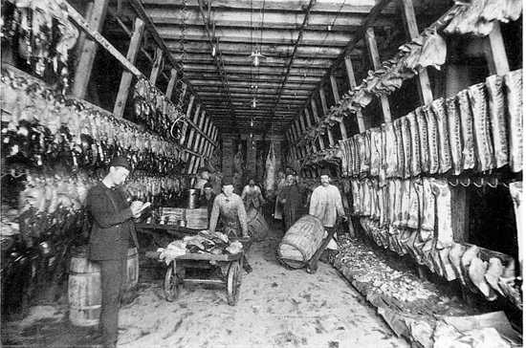
Quick Class Discussion: Why do you think the book generated outrage from Americans and politicians?

Slide 19
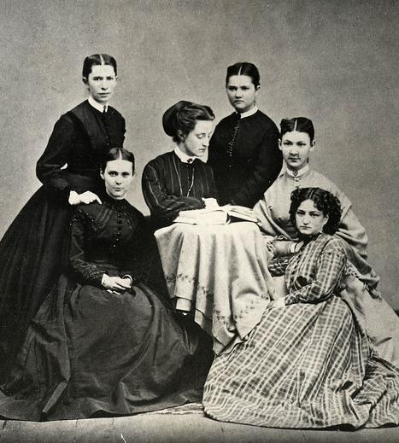
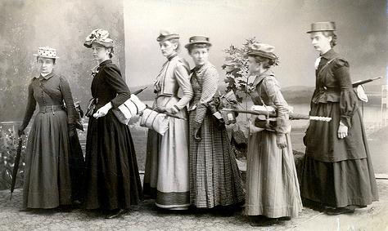
The Progressive Era led to demands for equal rights by women
Quick Class Discussion: In what ways were women discriminated against?
In most states, married women could not divorce or own property
Women could not vote, but black, immigrant, and illiterate men could
Women workers were paid less than men
Women were expected to remain at home as wives and mothers

Slide 20
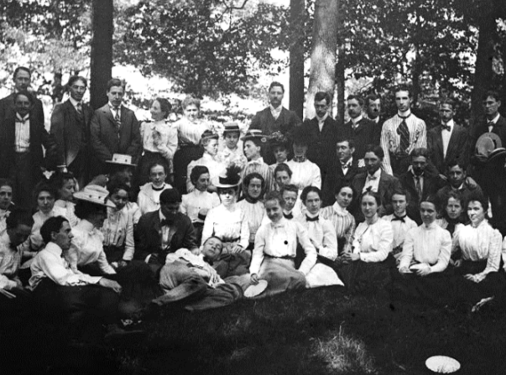
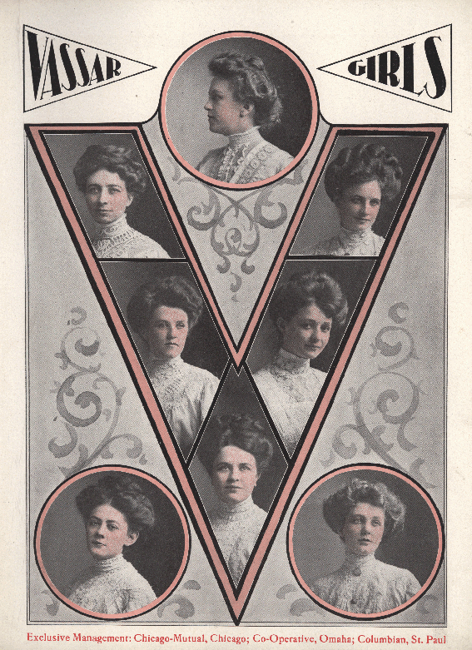
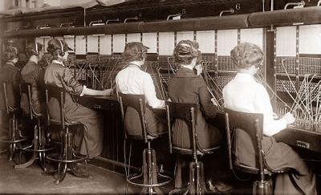
The Gilded Age brought new opportunities for women and new ideas about personal rights
Women lived independently in cities as secretaries, store clerks, telephone operators
More girls graduated from high school and attended universities
Graduating class of 1898, Oberlin College

Slide 21
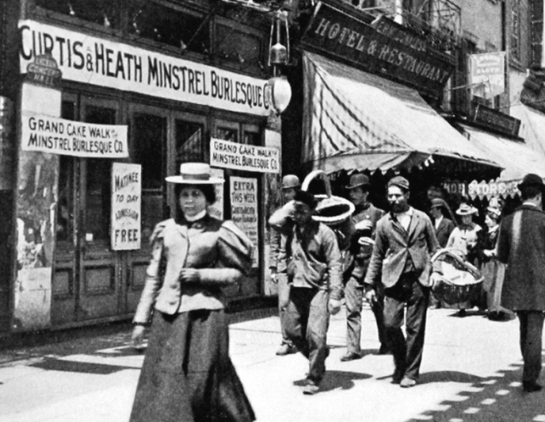
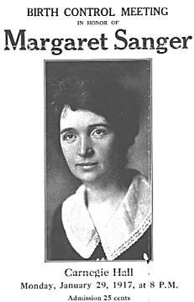
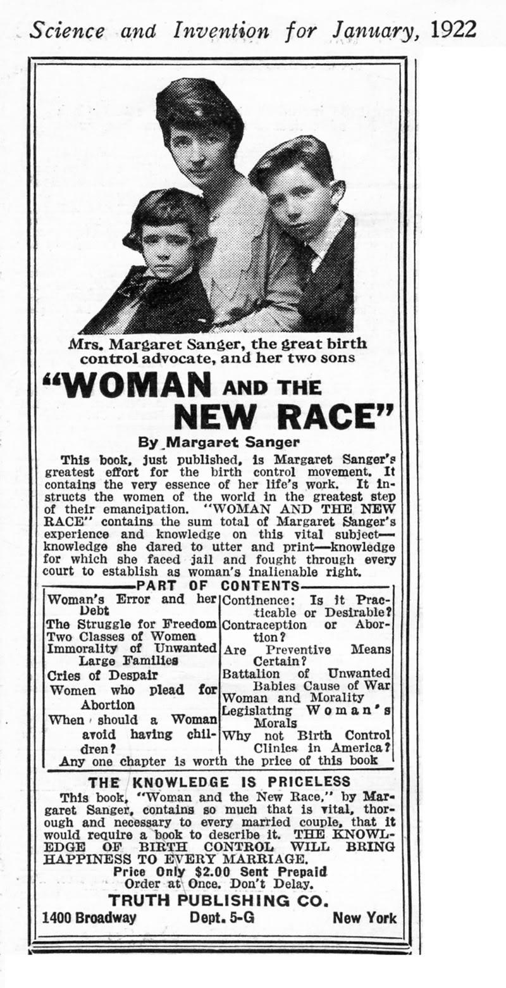
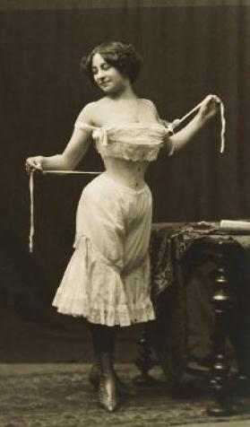
Women reformers gained laws that banned prostitution
Margaret Sanger promoted birth control for poor and middle-class women and opened the first birth control clinic in the U.S. in 1915

Slide 22
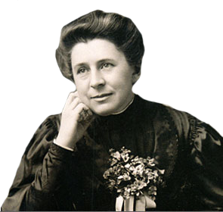
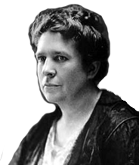
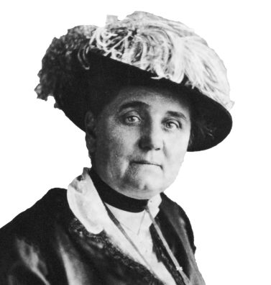
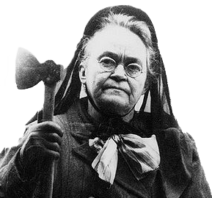
During the Progressive Era, many women took the lead and played important roles as reformers
Jane Addams created the first settlement house
Muckraker Ida Tarbell exposed corporate monopolies
The WCTU fought for prohibition laws
Florence Kelley helped bring about child and women labor laws

Slide 23
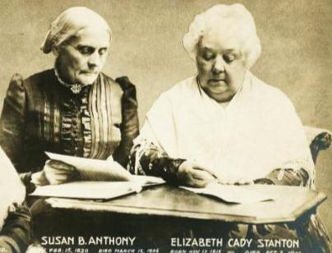
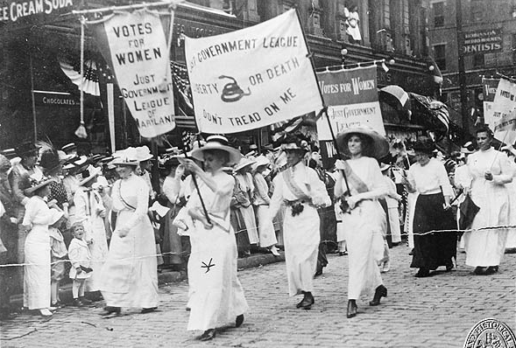
The most significant reform for women was the demand for suffrage (voting rights)
Women demanded property and voting rights in 1848 at the Seneca Falls Convention
Women were frustrated after the Civil War in when black men gained the right to vote (15th Amendment) but women did not
In 1890, Susan B. Anthony and Elizabeth Stanton formed the National American Women Suffrage Association (NAWSA)

Slide 24
NAWSA leaders pressured states to let women vote and called for a national suffrage amendment

Slide 25
By the early 1900s, most western states allowed women to vote but women in the East could not vote

Slide 26
In 1920, the states ratified the 19th Amendment giving women to right to vote

Slide 27
Women’s Suffrage
https://www.youtube.com/watch?v=pFOieRHRzh8
What arguments does the video make in favor of women’s suffrage?

Slide 28
The Progressive Era led to demands for equal rights by African Americans
Quick Class Discussion: In what ways were blacks discriminated against?
80% of lived in rural areas in the South, most as sharecroppers
Lynching and violence were common
Literacy tests and poll taxes limited black voting
Jim Crow laws segregated blacks in schools, hotels, restaurants, trains, and other public facilities
Plessy v Ferguson (1896) declared that segregation did not violate the 14th amendment

Slide 29
Black civil rights leaders were divided on how to address racial problems
Booker T. Washington was born a slave in Virginia and used hard work and education to become a teacher after the Civil War
He founded the Tuskegee Institute, a school to train black workers and teachers
On race relations, he argued in favor of accommodation: Blacks should work hard, educate themselves, and earn the rights they wanted

Slide 30
“Our greatest danger is that in the great leap from slavery to freedom, we may overlook the fact that the masses of us are to live by the productions of our hands and fail to keep in our mind that we shall prosper as we learn to dignify and glorify common labor…It is at the bottom of life we should begin and not the top…In all things that are purely social, we can be as separate as the fingers, yet one as the hand in all things essential to mutual progress.”
—Booker T. Washington
”Atlanta Compromise” (1895) Atlanta Cotton States Exposition

Slide 31
WEB DuBois had a very different view of race relations than Booker T. Washington
DuBois was born in Massachusetts and was the first black man to earn a doctorate from Harvard
He opposed Washington’s “Atlanta Compromise” and…
…called for immediate civil rights and the promotion of the “Talented Tenth” of young black leaders

Slide 32
WEB DuBois had a very different view of race relations than Booker T. Washington
We claim for ourselves every single right that belongs to a free American, political, civil and social, and until we get these rights we will never cease to protest and assail the ears of America
—W.E.B. DuBois

Slide 33
In 1905, DuBois and other black leaders led the Niagara Movement
…They demanded an end to segregation and discrimination and economic and educational equality
The meeting led to the formation of the National Association for the Advancement of Colored People (NAACP) in 1909 to fight for black equality

Slide 34
The NAACP fought voting restrictions and segregation laws by using the 14th Amendment to file lawsuits
WEB DuBois was the most outspoken early member of the NAACP by using The Crisis newsletter to call attention to black causes

Slide 35
Jamaican immigrant Marcus Garvey believed that whites and blacks could not coexist in America
In 1907, he founded the Universal Negro Improvement Association to encourage blacks to return to Africa
He created a number of businesses to promote Black Nationalism
Garvey lost credibility when he was jailed for mail fraud and deported to Jamaica

Slide 36
While women gained voting rights and labor laws…
…African Americans were unable to end Jim Crow segregation, stop lynching, or gain economic equality
But, black leaders in the Progressive Era inspired later generations to demand changes

