Slide 1
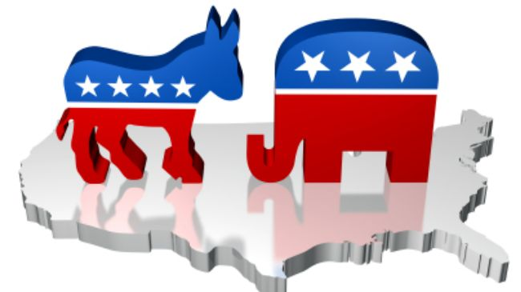
Do Now- 12/7
What do Americans look for when electing a new leader?

Slide 2
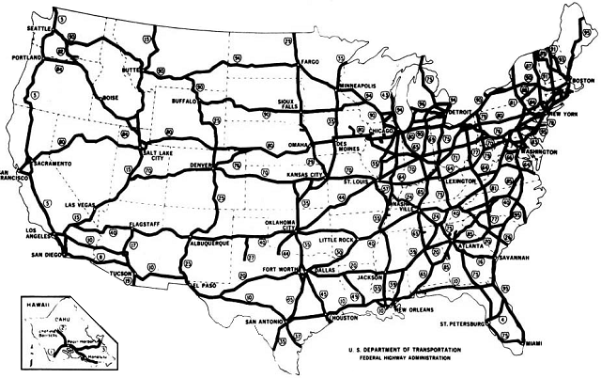
Eisenhower Interstate Highway System
The Federal-Aid Highway Act of 1956 authorized 41,000 miles of highway construction at a cost of $25 billion. The original plan took 35 years to complete at a cost of over $100 billion. Today there is over 47,000 miles of interstate highway. These routes made possible a veritable explosion of economic productivity after World War II, allowing goods to move to market much more easily.

Slide 3
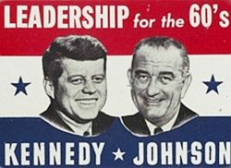
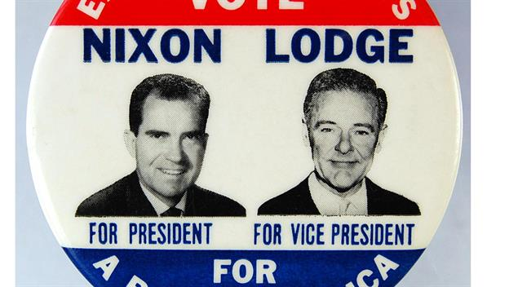
Election of 1960
vs.
http://www.history.com/topics/us-presidents/presidential-elections/videos/the-first-jfk-nixon-debate
http://www.history.com/topics/us-presidents/john-f-kennedy/videos/jfk-a-new-generation?m=528e394da93ae&s=undefined&f=1&free=false

Slide 4
Election of 1960
In what ways was the televised debate influential on Kenney’s eventual election? How did the debate hurt Nixon’s campaign?

Slide 5
What was Kennedy’s position on Civil Rights? Were his views like or unlike the views of other politicians who we have discussed recently?
What is “flexible response?” Why was it important?

Slide 6
Cold War Continues
Bay of Pigs Invasion
http://www.history.com/topics/cold-war/bay-of-pigs-invasion/videos/bay-of-pigs-cias-perfect-failure
Cuban Missile Crisis
http://www.history.com/topics/cold-war/bay-of-pigs-invasion/videos/cuban-missile-crisis?m=528e394da93ae&s=undefined&f=1&free=false

Slide 7
Video Questions
Bay of Pigs Invasion
Who is Fidel Castro? Why was he an enemy of the United States in the 1960s?
Why did the United States invade Cuba?
What was the result of the invasion?
Cuban Missile Crisis
How was the Cold War escalated by both the U.S. and Soviet Union?
What steps did the U.S. take to prevent nuclear weapons from getting to Cuba?
What was the result of the crisis?

Slide 8
Legacy of the Events
http://abcnews.go.com/International/video/history-us-cuba-relations-30146169
Explain the importance of U.S. relations with Cuba in terms of the tension between Democracy and Communism.
In what ways did bringing the Cold War closer to the U.S. influence foreign policy and American society?
How did the failure of the Bay of Pigs Invasion and Cuban Missile Crisis influence U.S policy towards Cuba for the next 50 years?

