Slide 1
Do Now- 10/26
Look at our Social Contract. Is there anything you think we need to add for this Quarter?
What are 2 things from the Social Contract you think you personally followed well 1st Quarter and what is 1 thing you think you could improve on?
What will you do this Quarter to improve the way you follow the Social Contract?

Slide 2
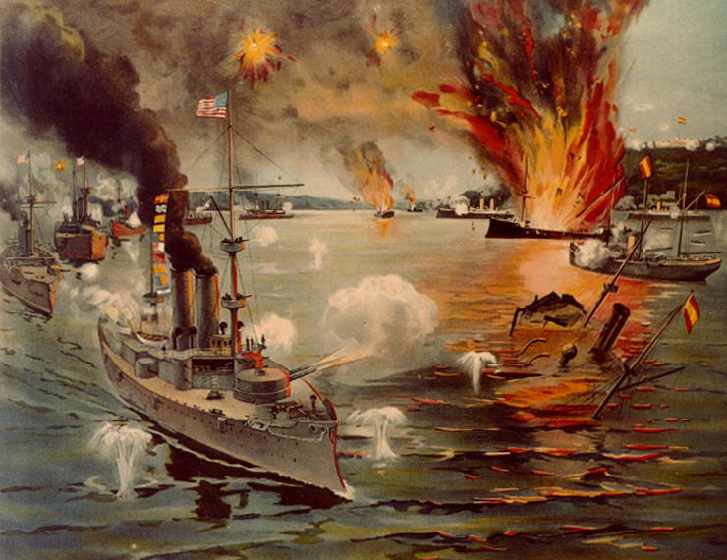
Spanish American War- Fast Facts
April 25, 1898- August 12, 1898
“A splendid little war”
Naval battles in Cuba and the Philippines
Began after the U.S.S. Maine was sunk in Havana Harbor, Cuba
Brought about “yellow journalism”
U.S. Victory
https://www.youtube.com/watch?v=4PK5XvSxJhU

Slide 3
Video Questions
Where was the Spanish American War fought?
What caused Americans to support a war against Spain?
What happened in Cuba to cause Spain to get involved in the area?
What places did the United States gain as territories following the end of the Spanish American War?

Slide 4
Reading
Read the article independently and annotate as you read.
The Underlined Bold words are vocabulary to focus on.
After you read you must answer the questions and fill out the vocabulary chart on the back. We will go over this as a class afterwards.

Slide 5
Do Now- 10/27
Without looking at yesterday’s work, what are 2 things you remember about the Spanish American War?

Slide 6
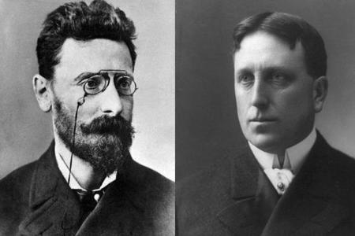
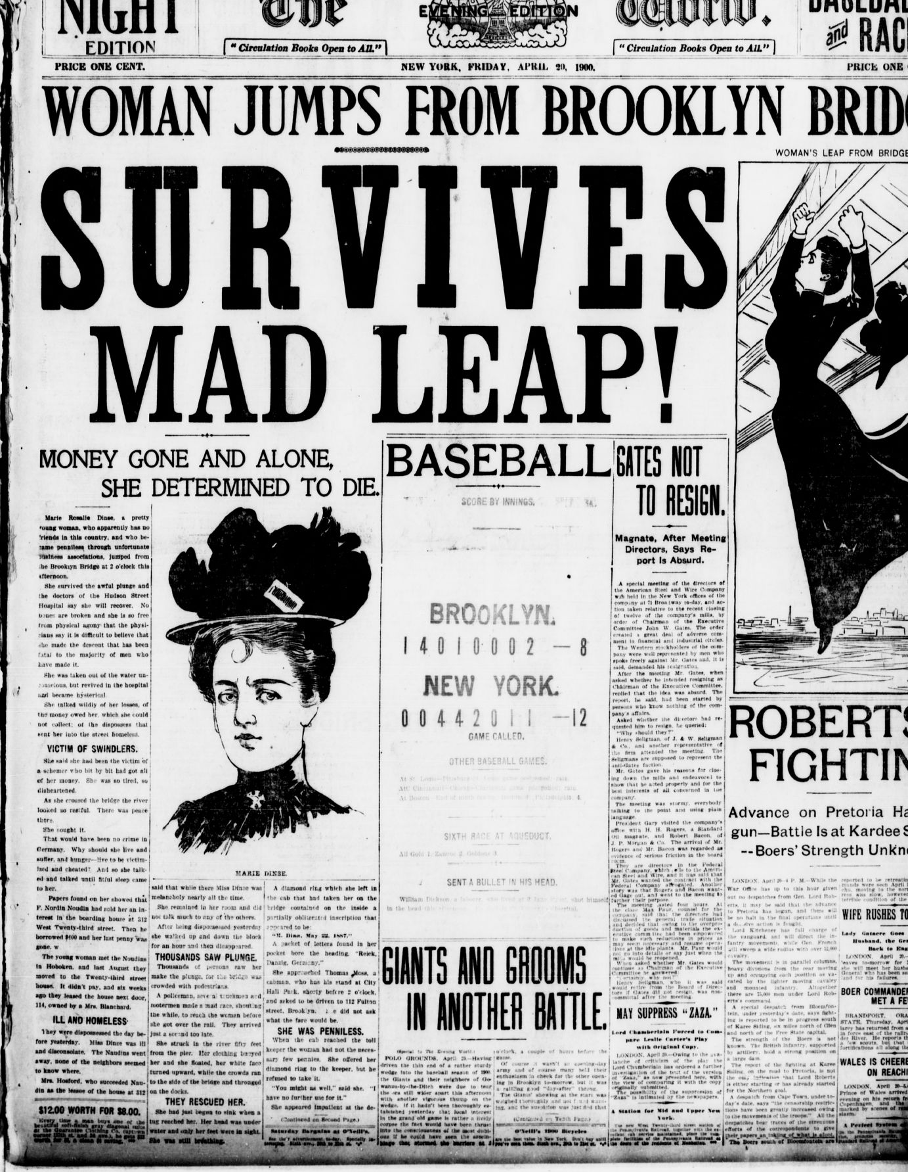
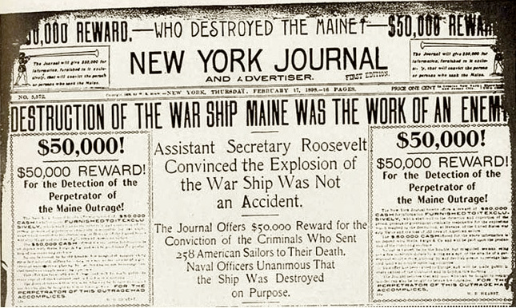
Yellow Journalism
Newspapers competed for sales by using attention getting headlines and pictures rather than well researched news stories.
Included unbelievable stories with “anonymous” sources
William Randolph Hearst’s New York Journal vs. Joseph Pullitzer’s New York World
"You furnish the pictures and I'll furnish the war.”- Hearst

Slide 7
Yellow Journalism- Write a Headline!
In pairs, you will be working as newspaper editors to complete your paper’s front page.
As “yellow journalists” you want your headlines to grab the attention of your readers and get them to buy your paper instead of your competition’s!
In order to get the most readers, you will need to include attention getting headlines and colorful pictures.
Complete the template provided and we will vote on whose paper we want to buy based on the front page.

Slide 8
Yellow Journalism- Write a Headline
You MUST include the following:
Title story headline must be about a historical or current event.
Color picture about the title story
3 other story headlines must be about things we learned 1st Quarter

Slide 9
Do Now- 10/28
What is the definition and purpose of Yellow Journalism?
Do we still see yellow journalism today? If so, where?

