Slide 1
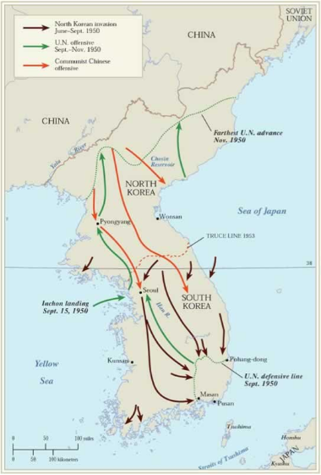
The Cold War Heats Up

Slide 2
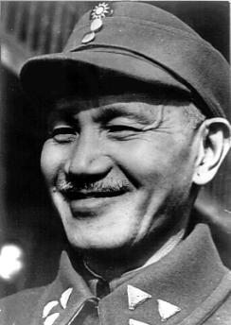
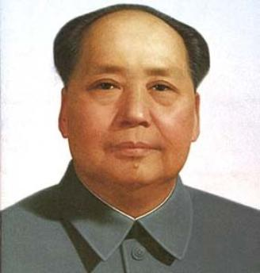
China and Taiwan
A Civil War breaks out in China between the
NATIONALIST led By Chiang Kai-Shek and the
COMMUNISTS lead by Mao Zedong.
Chiang Kai-Shek (Nationalist) Mao Zedong (Communist)
Who will the U.S.A
support?

Slide 3
Chinese Civil War
A. U.S. and Soviet Support
- The United States supports the Nationalist and Chiang-Kai Shek
- The Soviet Union supports the Communist and Mao Zedong.
- We support the Nationalist despite some of the negative policies they have towards their own people.
- EX) Having a grain tax during a famine.
B. Outcome
- The Nationalist are forced of the Chinese mainland and forced unto the island of Taiwan.

Slide 4
Chinese Civil War
C. The United States’ Reaction to Communist Takeover
1) Americans were stunned that CONTAINMENT had failed and further worried that other countries would fall to Communism. (DOMINO THEORY)
2) The Fear of Communism was increased and would only get worse after events in Korea a year later.

Slide 5
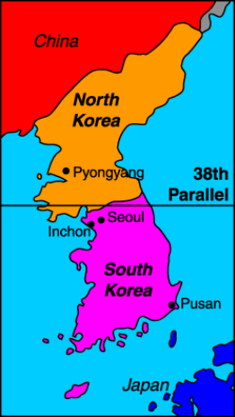
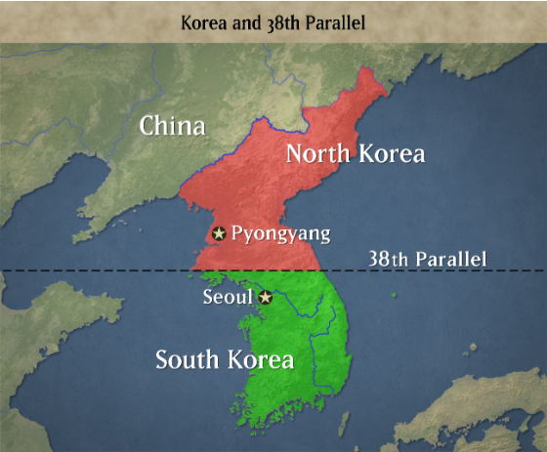
The Korean War
At the end of World War II Japan had surrendered Korea to both the Soviets and the US. The dividing line was the 38th parallel…Communism to the North, Democracy to the South.
The 38th Parallel – Dividing line between Communist North Korea and Democratic South Korea.

Slide 6
The Korean War
June 1950 North Korea invades South Korea
June 1950 – South Korea’s capital is captured
September 1950 – North Korea pushes South Korea to the tip of the peninsula.
October 1950 – UN (mostly US) troops push North Korea back towards China
January 1951 – Chinese troops force UN troops back to the 38th parallel.

Slide 7
Outcome of Korean War
1) 54,000 U.S. casualties
2) Increased fear of Communist aggression and prompted a hunt for spies on whom to blame Communist gains around the world.
3) Creation of HUAC (House Committee on Un-American Activities)
BLACKLISTING – Condemning of a person for having Communist sympathies or background.

Slide 8
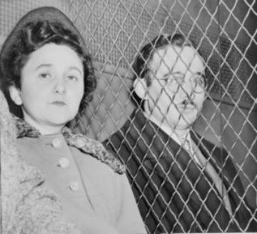
The Rosenbergs
Ethel and Julius Rosenberg were tried and convicted off giving the Soviet Union information about the United States atomic bomb. (The Russians were able to test and atomic bomb 3-5 years before the US anticipated they would be able to)
The Rosenberg’s pleaded the 5th and claimed they were being persecuted because they were Jewish and minor members of America’s Communist
party.
- The couple was executed in the
electric chair in June of 1953.

Slide 9
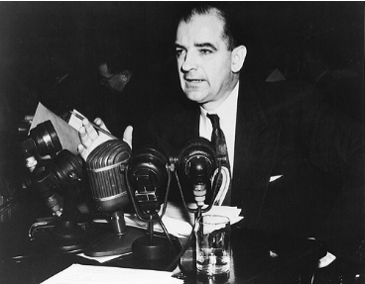
McCarthy Witch Hunt Hearings
McCarthyism – Attacks on suspected Communist in the early 1950s. (It almost always included accusing people of being Communist with very little evidence)
- Senator Joseph McCarthy claims that the U.S. Government is being taken over by Communist and the Democratic Party was a Communist friendly organization.
- Millions investigated, jailed and forced to quit labor unions.
- McCarthy’s downfall: Made
accusations against the U.S. Army,
lost support because of this and his
performance at the televised Senate
hearings that followed.

