Slide 1
Chapter 18-2 The Spanish American War
Mr. Hammill
Phillip O Berry HS

Slide 2
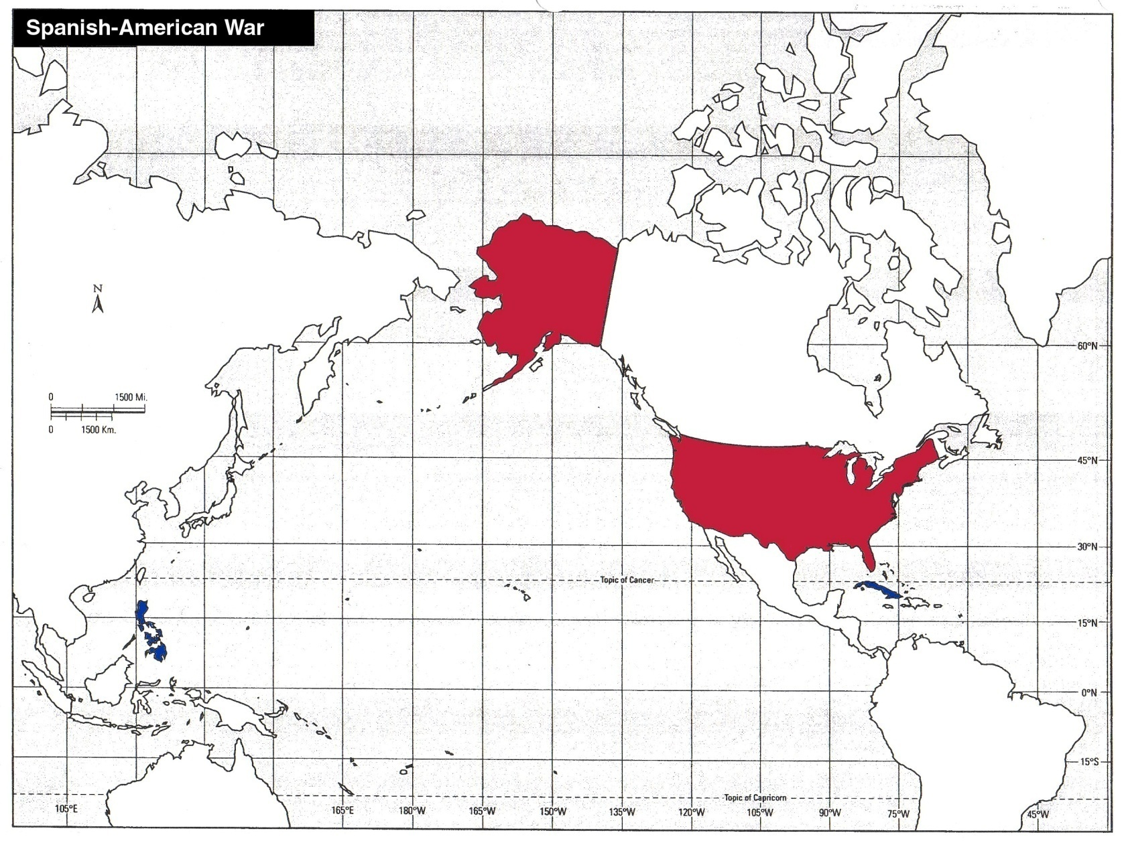
Where was the war fought?
USA
The Philippines
Cuba

Slide 3
Problems in Cuba
Cubans rebelled between 1868-78 fighting for independence from Spain, but it failed
José Martí launched another war for independence from Spain in 1895.
Americans interested because lots of natural resources are close to them!!! (economic)

Slide 4
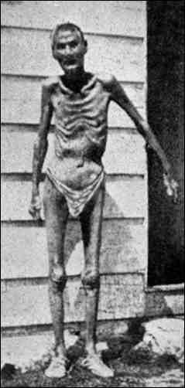
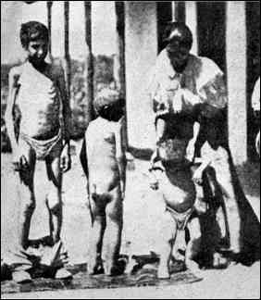
Problems in Cuba Cont.
Spanish General Valeriano Weyler
Put many civilians in barbed-wire concentration camps

Slide 5
Yellow Journalism
What is yellow journalism?
Sensational style of writing that exaggerates the news to lure and enrage readers
New York Journal was owned by William Randolph Hearst
New York World was owned by Joseph Pulitzer
Both men did anything to increase war fever
“You furnish the pictures and I’ll furnish the war”
William Randolph Hearst to his photographer
Notes:
Printed exaggerated accounts of Weyler’s actions such as children being thrown to the sharks in order to gain American sympathy for the rebels

Slide 6
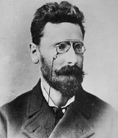
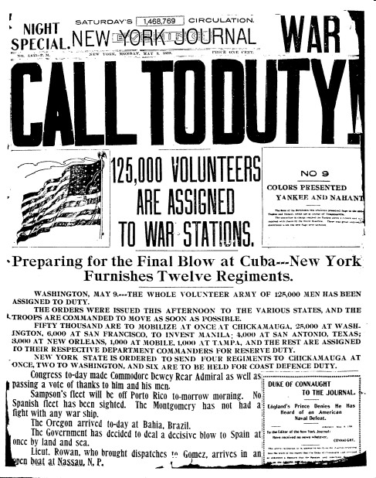
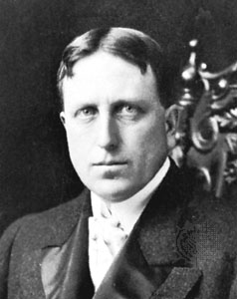
“Yellow Journalism” & Jingoism
Joseph Pulitzer
Jingoism: A belief in violent nationalism. Wanting to go to war!
William Randolph Hearst

Slide 7
YELLOW JOURNALISM
How long shall Cuban women be the victims of Spanish outrages and lie sobbing and bruised in loathsome prisons?
How long shall women passengers on vessels flying the American flag be unlawfully seized, stripped and searched by brutal, jeering Spanish officers, in violation of the laws of nations and of the honor of the U.S.?
How long shall American citizens, arbitrarily arrested while on peaceful and legitimate errands, be immured in foul Spanish prisons without trial?
How long shall the U.S. sit idle and indifferent within sound and hearing or rapine and murder?
HOW LONG?
yellow journalism

Slide 8
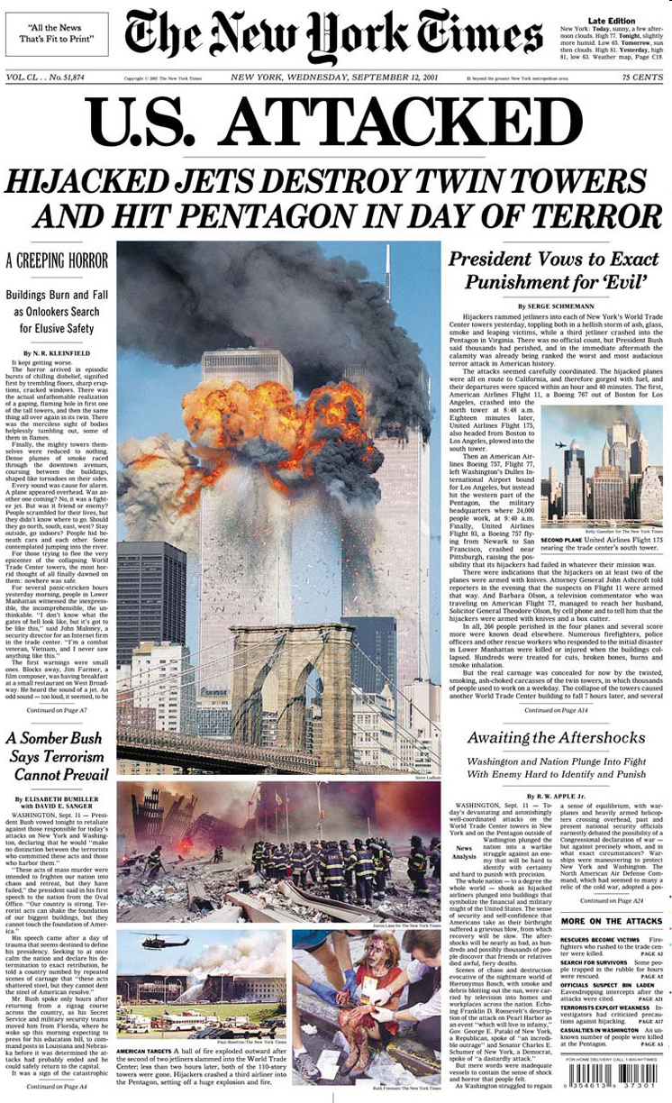

Slide 9
The De Lome Letter
McKinley used diplomacy to mediate the conflict between Spain and Cuba
Spanish Minister to U.S. wrote a letter calling McKinley “weak”
Cuban rebel stole it and Hearst published it

Slide 10
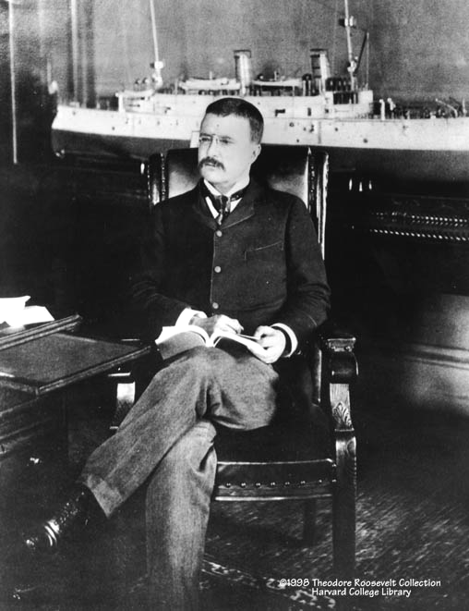
Theodore Roosevelt
Assistant Secretary of the Navy in the McKinley administration.
Imperialist and American nationalist.
Criticized President McKinley as having the backbone of a chocolate éclair!
Resigns his position to fight in Cuba.

Slide 11
Explosion of the Maine
President McKinley ordered the U.S.S. Maine to Cuba to bring home American citizens in danger and protect U.S. property
February 15, 1898 the ship mysteriously exploded killing all 260 men on board
Heast and Pulitzer sensationalized the story blaming Spain
“REMEMBER THE MAIN, TO HELL WITH SPAIN”
All the sailors died

Slide 12
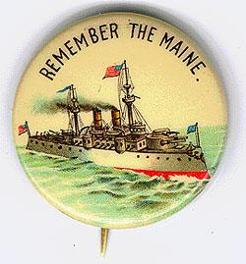
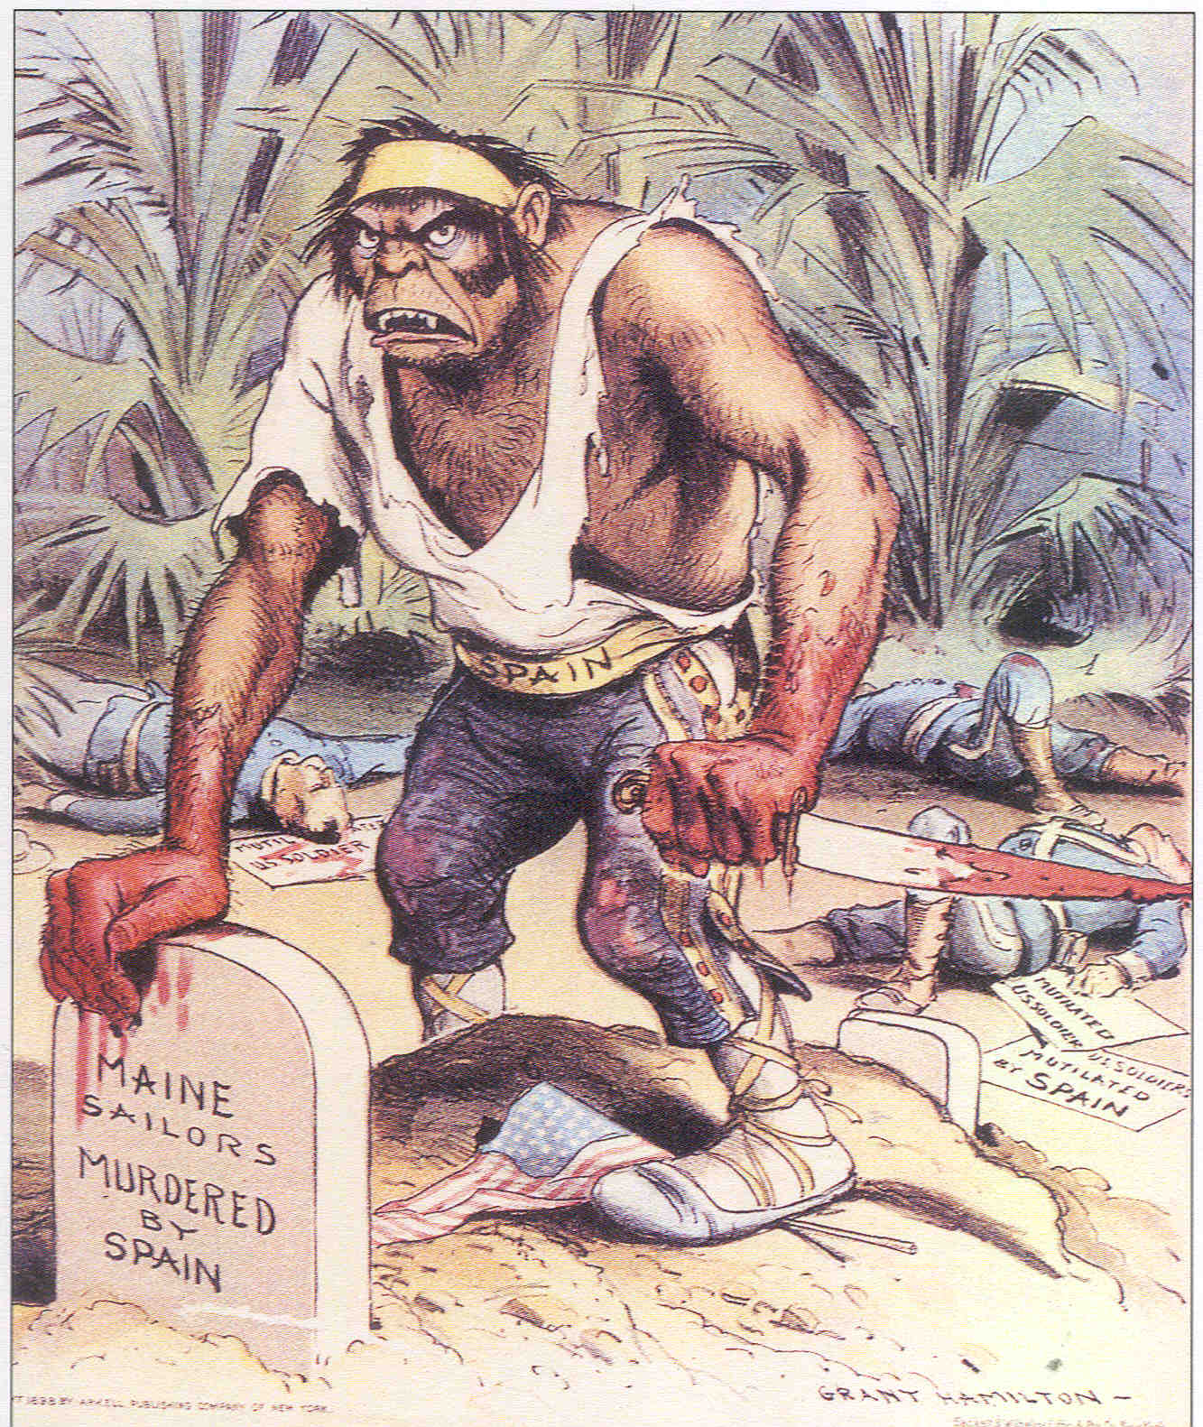
Remember the Maine and to Hell with Spain!

Slide 13
WAR!
April 9: Spain agreed to all U.S. demands including a 6 month cease-fire
April 11: McKinley asked Congress for authority to use force against Spain
April 20: US declared War
Why did McKinley declare war despite Spanish concessions?

Slide 14
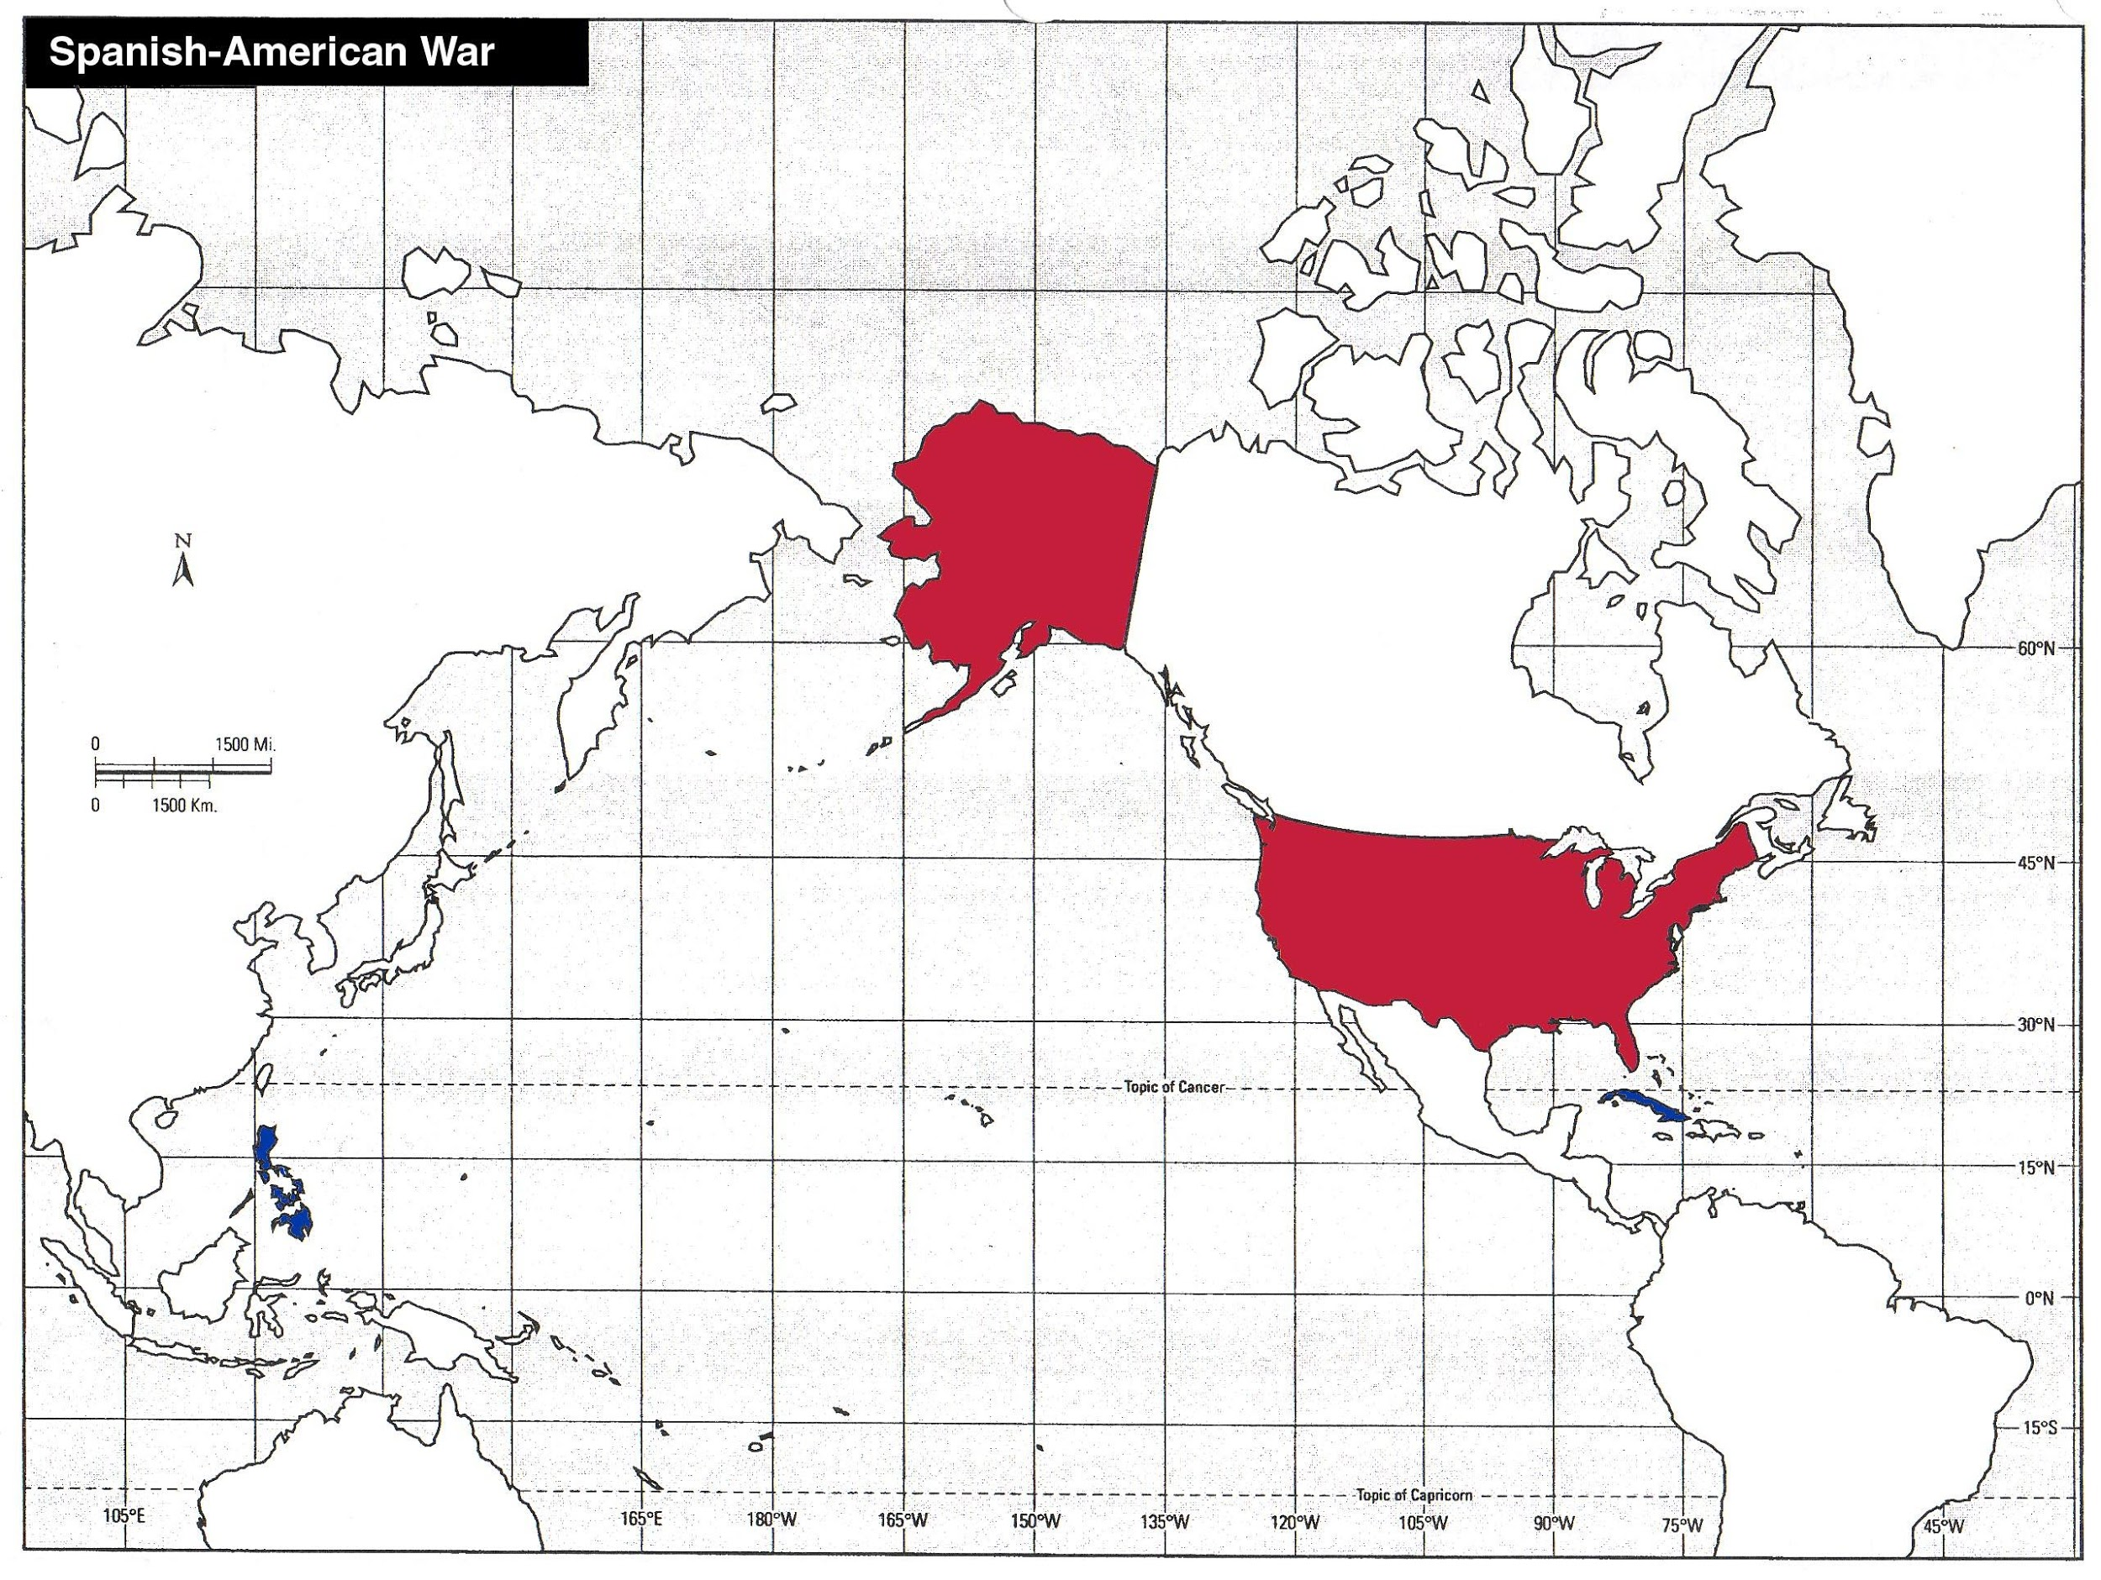
USA
Cuba
The Philippines

Slide 15
The Spanish-American War (1898): “That Splendid Little War”

Slide 16
Invasion of Cuba
U.S. had only 125,000 men that volunteered and sent to training camps
June 1898: US Army set sail for Cuba
July 1st : Rough Riders (led by Theodore Roosevelt) and 2 African-American regiments captured Kettle Hill and cleared the way to capture San Juan Hill
July 3rd: Spanish fleet tried to escape Santiago harbor but was destroyed

Slide 17
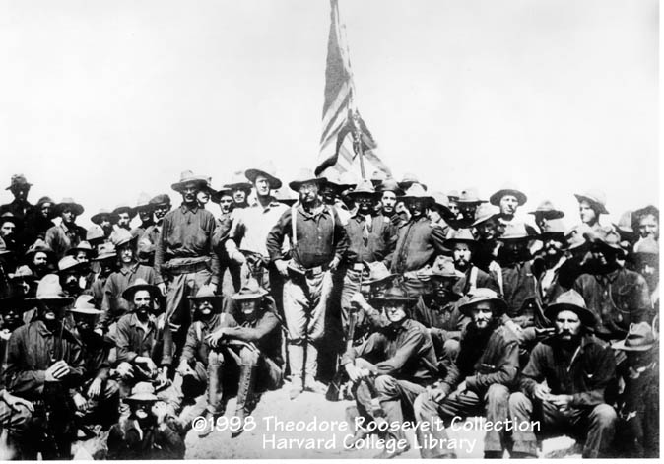
The “Rough Riders”

Slide 18
The Philippines

Slide 19
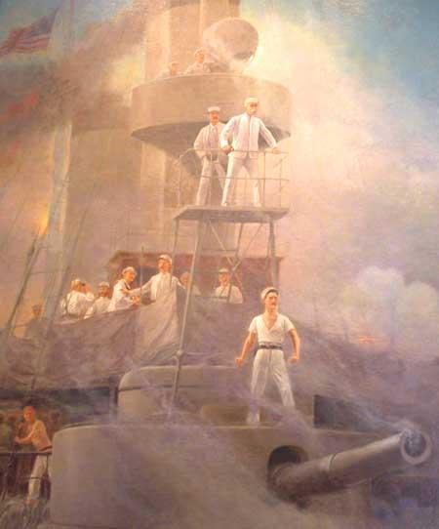
War in the Philippines
April 30: U.S. fleet under the command of Commodore George Dewey destroyed the entire Spanish fleet at Manila Bay
Over next 2 months, US troops fought alongside Filipino rebels
Spanish troops surrendered in Manila in August to the United States
Commodore Dewey on the cruiser Olympia

Slide 20
The Spanish-American War (1898): “That Splendid Little War”

Slide 21
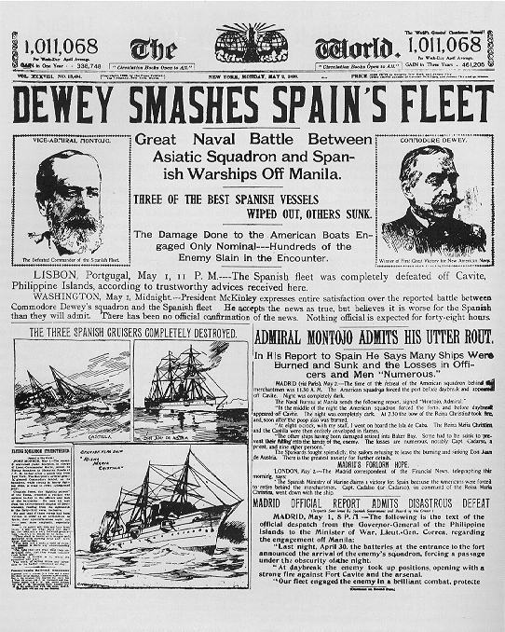
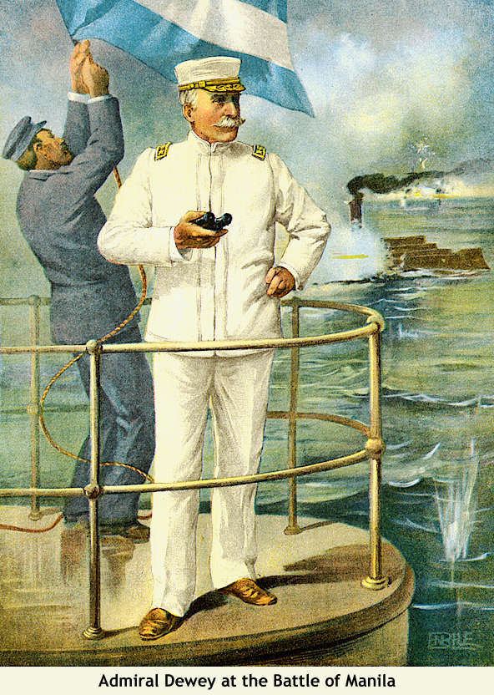
Dewey Captures Manila!

Slide 22
WARM-UP!
Open your binders to the Spanish American War handout from Thursday
I need 8 volunteers to go stand in the front of the room please!

Slide 23
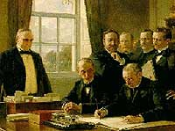
The Treaty of Paris: 1898
Cuba was freed from Spanish rule but became a U.S. protectorate because of the Platt Amendment
Spain gave up Puerto Rico,the Philippines,and the island of Guam to the United States
The U. S. becomes an imperial power!
Jingoism: extreme patriotism
by using violent foreign policy

Slide 24
EXPANSION ARGUMENTS
FOR EXPANSION
Keep up with European nations
Desire for prestige
Theory of racial superiority
Provide market for surplus goods and investments
AGAINST EXPANSION
America’s vastness provided enough of an outlet for the country’s energies
America should not rule over other peoples
“Might does not make right”
Anti-Imperialist League
Mark Twain
Andrew Carnegie
Susan B. Anthony
William Jennings Bryan
Imperialists
Theodore Roosevelt
William Mckinley
William Randoph lHearst
Joseph Pulitzer

Slide 25
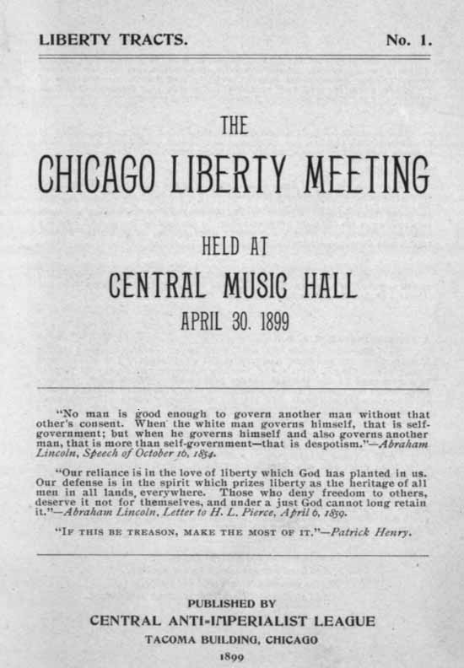
The American Anti-Imperialist League
Founded in 1899.
Mark Twain, Andrew Carnegie,and William Jennings Bryan among the leaders.
Campaigned against the annexation of the Philippines and other acts of imperialism.

Slide 26
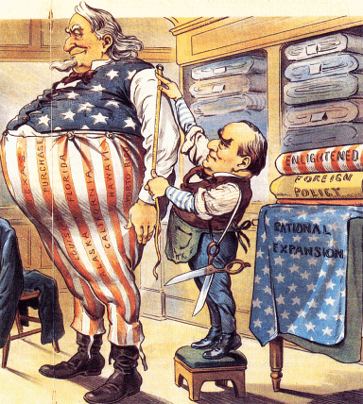
The Imperialist Taylor

Slide 27
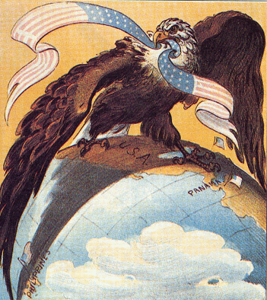
Our “Sphere of Influence”

Slide 28
Reflection:
Write a paragraph addressing the following questions
How big is your personal “sphere of influence”? Who is involved in your sphere and in what ways are they impacted by you?
Who’s spheres of influence are you a part of? In what ways do the people around you influence your thoughts and behaviors?
How are individuals’ spheres of influence similar and different from a country’s?

