Slide 1
Do Now- 10/29
Complete the survey at http://j.mp/hardingstudentsurvey
2. What do you remember about WWI?
Which countries were involved?
What was the outcome?
How did it change America? World?

Slide 2
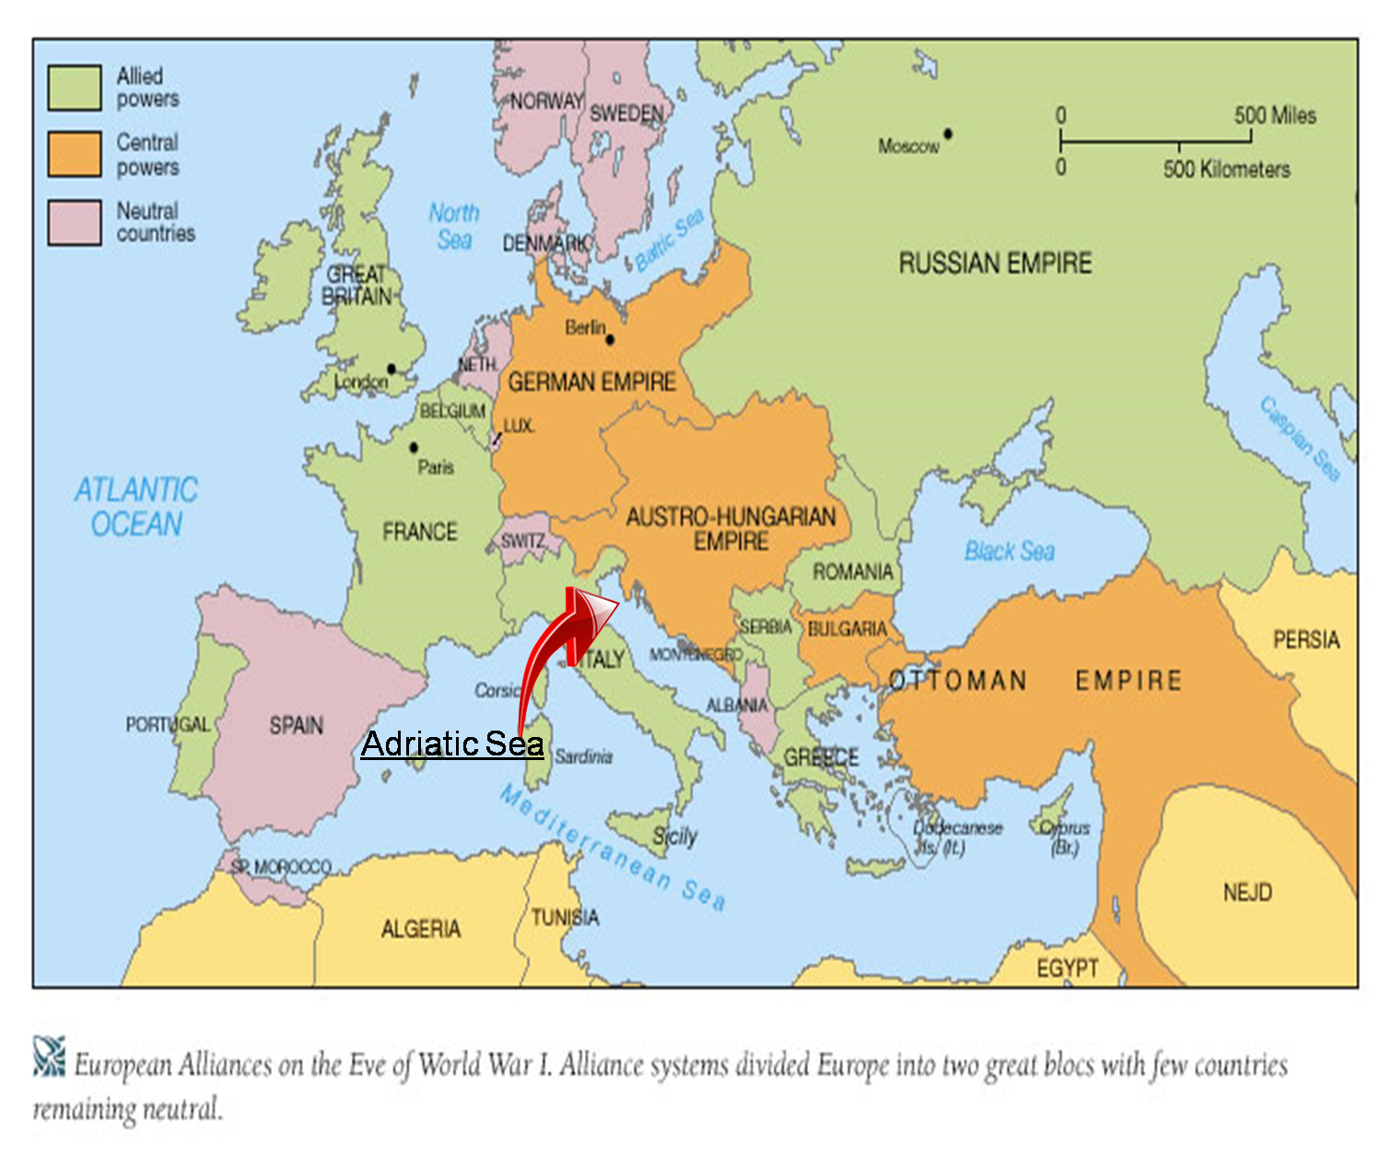
What were the MAIN causes of World War I?
MILITARISM
ALLIANCES
IMPERIALISM
NATIONALISM

Slide 3
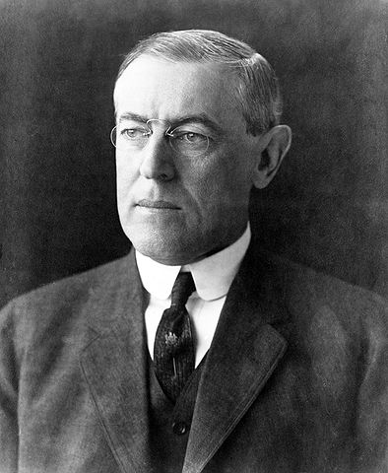
Declaration of Neutrality
What promise does Wilson make to the American people?
Do you think it is possible for him to keep this promise?
2. What does this statement mean to you?
The people of the United States are drawn from many nations, and chiefly from the nations now at war. It is natural and inevitable that there should be the utmost variety of sympathy and desire among them with regard to the issues and circumstances of the conflict...the people of the United States … may be divided in camps of hostile opinion,

Slide 4
Do Now 10/30
What does it mean for a country to remain neutral?
Is it good or bad to stay neutral during a conflict?

Slide 5
U.S. Enters the War
https://www.youtube.com/watch?v=tP8p1uD3-Cg
Discussion:
What happened in the war to make the US people rethink their position?
What was Wilson’s declaration to the people in 1916? Is this possible?
In your opinion, what does the statement The War to End all Wars mean?
#1 How did the US’s entry into WW1 affect the nation's already involved in the conflict?

Slide 6
As you read:
Underline main ideas
Circle bolded words and their definitions
!! next to exciting/surprising statements
?? next to words or statements you do not understand
Write any additional notes or questions in the margins
***Annotated reading will be graded along with the worksheet
https://www.youtube.com/watch?v=izS67QTVAjk

Slide 7
Summarize World War I
On a lined sheet of paper, summarize the events of World War I and American involvement in the war.
Needs to be at least 10-15 sentences in length (multiple paragraphs).
Use 4-5 examples to justify your answer

