Slide 1
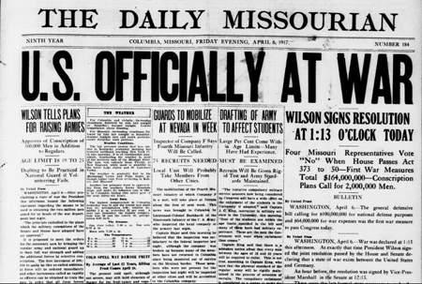
Do Now- 10/28
What do you know about U.S. involvement in World War I?

Slide 2
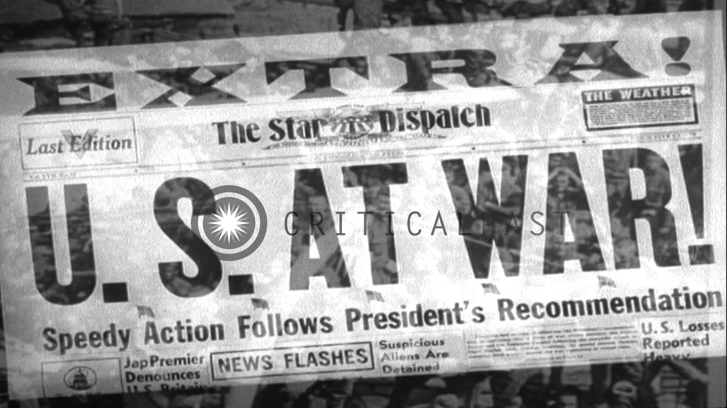
World War I

Slide 3
Daily Goals
Objectives:
evaluate Wilson’s leadership during the period of neutrality and his reasons for intervention
analyze ways the war impacted the world
Essential Question:
How did the industrial and technological advancements in this era impact America and the rest of the global community?

Slide 4
U.S. Enters the War
https://www.youtube.com/watch?v=tP8p1uD3-Cg
Discussion:
What happened in the war to make the US people rethink their position?
What was Wilson’s declaration to the people in 1916? Is this possible?
In your opinion, what does the statement “The War to End all Wars” mean?

Slide 5
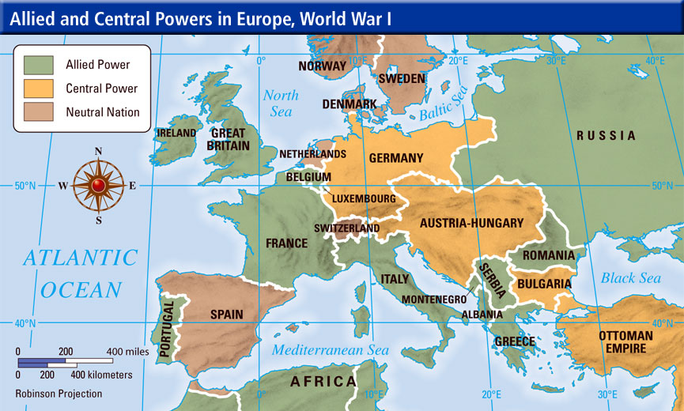
Perspectives and Impact
http://www.history.com/topics/world-war-i/treaty-of-versailles/videos/world-war-i-global-connections
http://www.history.com/topics/world-war-i/treaty-of-versailles/videos/world-war-i-global-connections

Slide 6
Video Questions
How did the Ally system draw countries into the war?

Slide 7
War Technology
http://www.history.com/topics/world-war-i/world-war-i-history/videos/tech-developments-of-world-war-i

