Slide 1
Do Now- 11/19
How might nativism play a role in American society today? Is this different than nativism in the early 20th century?
nativism- the policy of protecting the interests of native-born or established inhabitants against those of immigrants.
20th century Examples: KKK, Sacco-Vanzetti Trial

Slide 2
Do Now- 11/20
What conditions do you think allow for authoritarian leaders to emerge in countries around the world? What influence do these leaders have?
Authoritarian- favoring or enforcing strict obedience to authority, especially that of the government, at the expense of personal freedom.

Slide 3
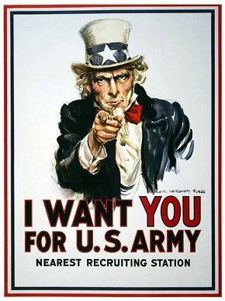
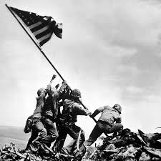
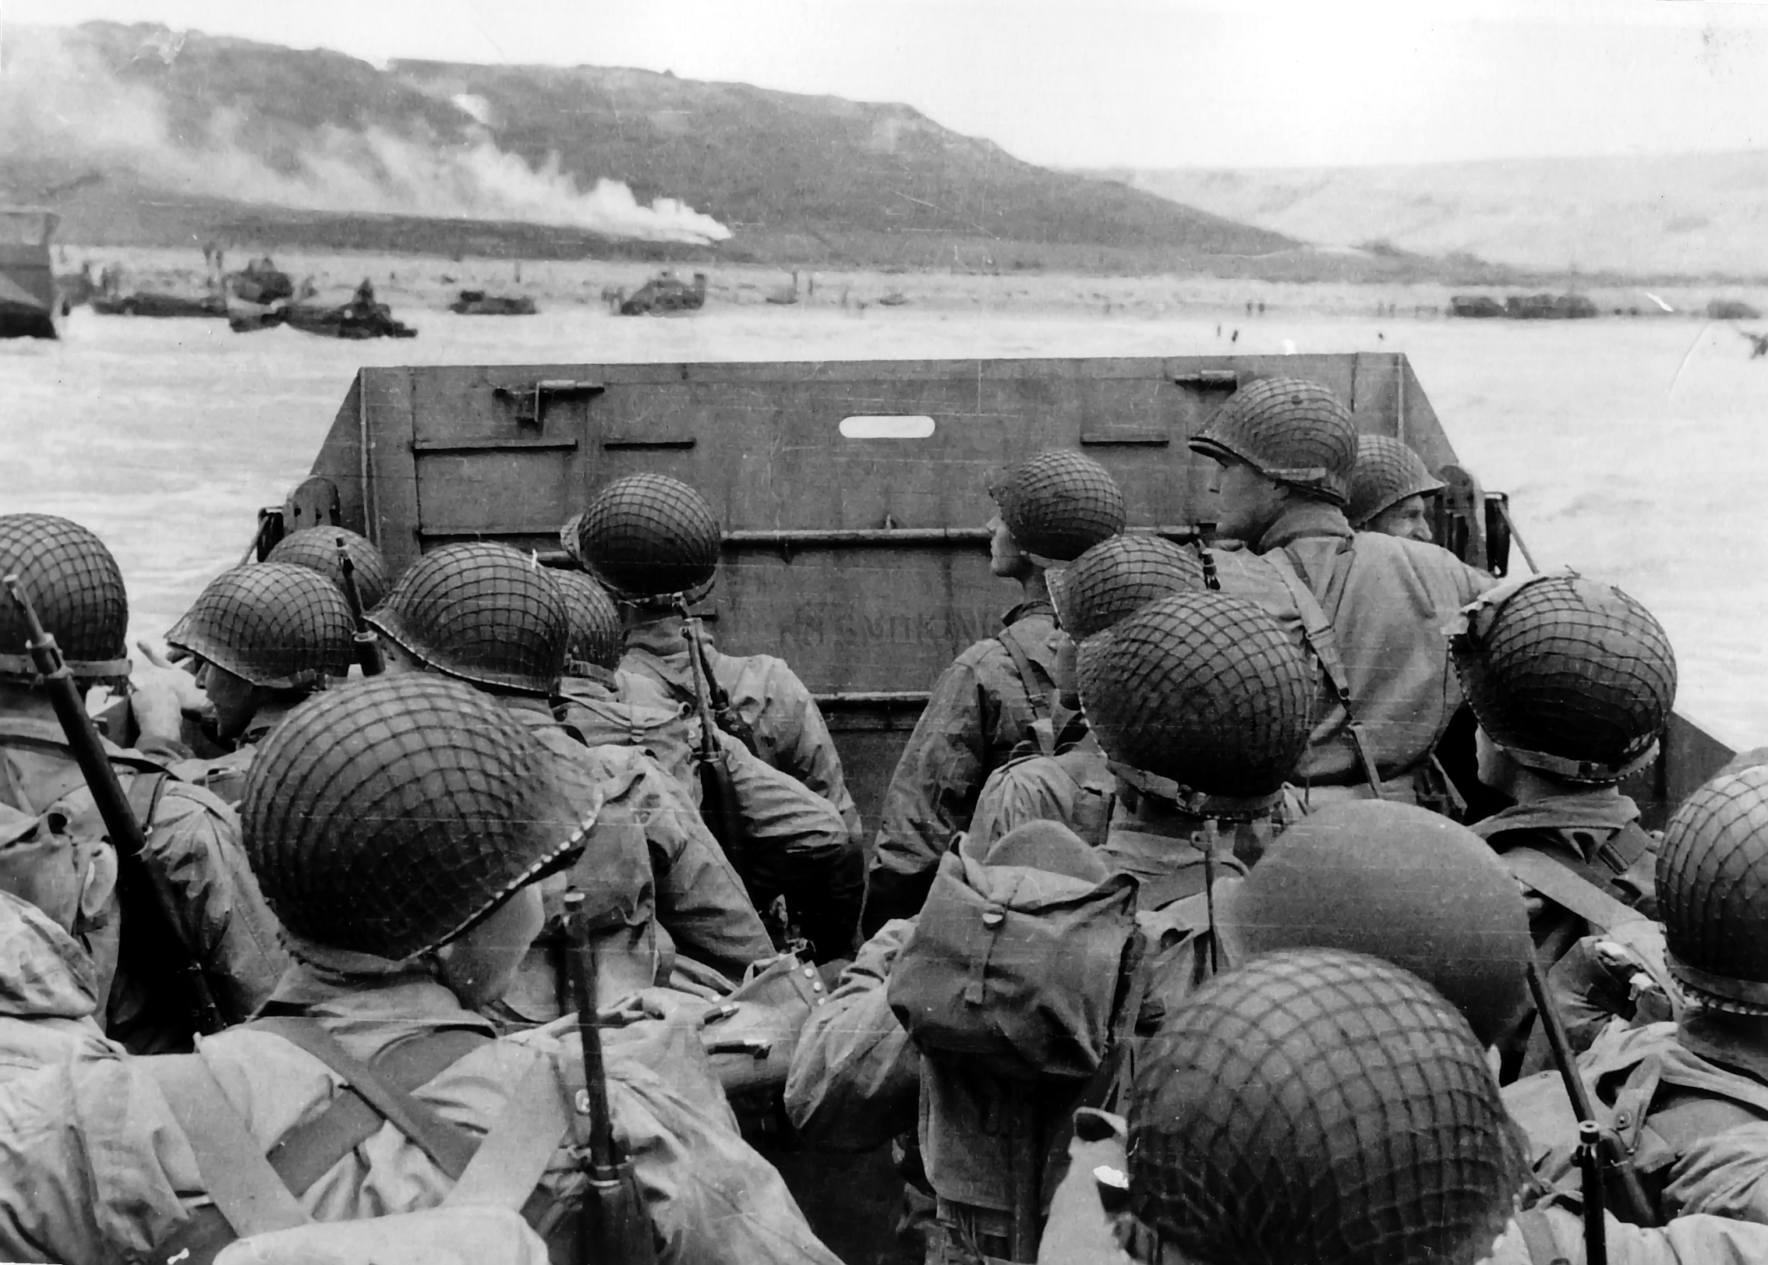
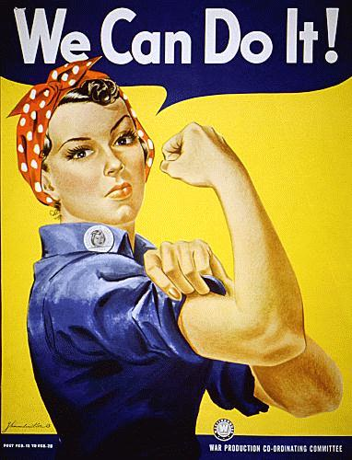
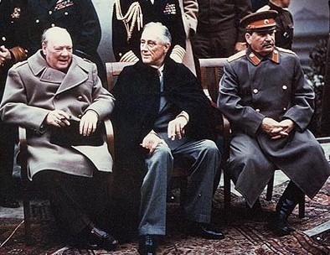
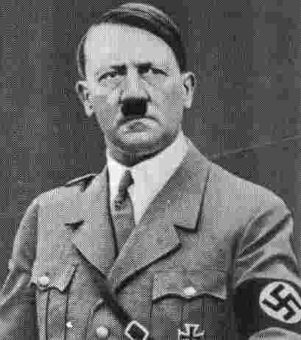
World War II

Slide 4
World War II and Dictators
KNOW | THINK YOU KNOW | QUESTIONS

Slide 5
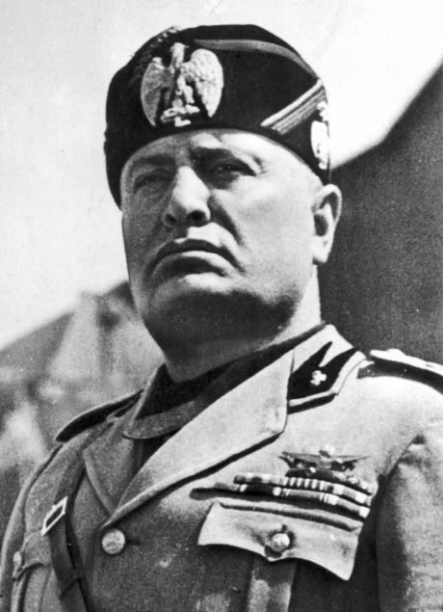
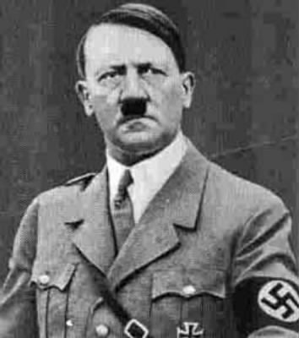
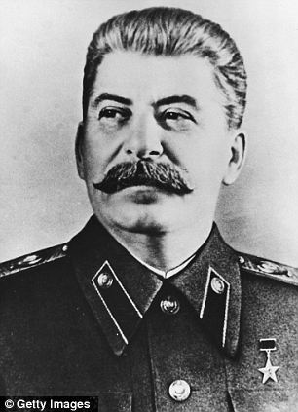
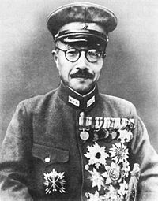
Rise of Dictators
Benito Mussolini- Italy, Leader of National Fascist Party 1922-1943
Adolf Hitler- Germany, Chancellor and Fuhrer of Nazi Germany 1933-1945
Joseph Stalin- USSR, Dictator of the Soviet Union 1922-1952
Hideki Tojo- Japan, Prime Minister 1941-1944

Slide 6
Dictators Questions
How were dictators able to rise to power and remain successful in Europe leading up to World War II?
2. What types of governments were dictators forming? How did these governments rule over their people?
3. In your opinion which dictator is the worst? Which ideology is the worst (Naziism, Fascism, Militarism, Communism) and why?
4. . In your opinion, how did the rise and success of these dictatorships lead to World War II?
5. Which of the 4 dictators described do you think was most influential? What new information you learned today surprised you most? Why?

Slide 7
Do Now- 11/23
What were the authoritarian countries during World War II and who were their leaders?
What ideologies did these governments follow?

Slide 8
Video Questions
What factors contributed to the start of World War II in Europe?
How was World War II a direct result of World War I?
What was the attitude in Germany that allowed for the rise of the Nazi Party?
Why did many Americans want to stay neutral at the beginning of World War II?
Why did the United States finally enter World War II?
http://www.history.com/topics/world-war-i/world-war-i-history/videos/did-wwi-lead-to-wwii
http://www.history.com/topics/world-war-ii/world-war-ii-history

Slide 9
Reading Questions
How did Roosevelt aid Great Britain without being pulled into the war?
What happened at Pearl Harbor on December 7, 1941?
If you were the Japanese, would you have attacked the U.S.? When and why?
How did the U.S. become fully enmeshed in World War II? Which military alliances fought during World War II?
How did America proceed to arm itself for war?
How did the U.S. finance the war effort?
How was the Great Depression finally brought to an end?
What steps were taken to combat inflation caused by the war?
What was the role of women and braceros during the war effort?
What were migration patterns for black Americans during the war? How did their efforts both abroad and at home contribute to their demands for equal rights?

Slide 10
Exit Ticket
How was the American homefront impacted by U.S. involvement in World War II?

Slide 11
Do Now- 11/24
What is one thing you learned and one thing you found interesting from yesterday’s videos or reading?

Slide 12
Do Now- 11/30
How was the American homefront impacted by U.S. involvement in World War II?

Slide 13
Monday’s Reading Debrief
How did Roosevelt aid Great Britain without being pulled into the war?
What happened at Pearl Harbor on December 7, 1941?
If you were the Japanese, would you have attacked the U.S.? When and why?
How did the U.S. become fully enmeshed in World War II? Which military alliances fought during World War II?
How did America proceed to arm itself for war?
How did the U.S. finance the war effort?
How was the Great Depression finally brought to an end?
What steps were taken to combat inflation caused by the war?
What was the role of women and braceros during the war effort?
What were migration patterns for black Americans during the war? How did their efforts both abroad and at home contribute to their demands for equal rights?

Slide 14
Japanese Internment
http://www.history.com/topics/world-war-ii/japanese-american-relocation/videos/japanese-internment-in-america
Why were Japanese Americans relocated to internment camps?
Was this relocation justified? Why or why not?
What were the conditions like in internment camps?
Japanese internment is often overlooked in American history. Why do you think that is? Is it important for Americans to learn this piece of history? Explain

Slide 15
End of WWII
Manhattan Project
http://www.history.com/topics/world-war-ii/trinity-test/videos/manhattan-project
Using the Atomic Bomb
http://www.history.com/topics/world-war-ii/world-war-ii-history/videos/atomic-bomb-ends-wwII
https://www.youtube.com/watch?v=h1tf8lv_yak (primary source footage)
https://www.youtube.com/watch?v=pX9hL93HPMI (film depiction)
https://www.youtube.com/watch?v=xIGSn-vh8hg (effects of bomb)

Slide 16
Video Questions
Answer the following questions in COMPLETE SENTENCES
What was the Manhattan Project?
Why did the United States first begin developing an atomic weapon?
Where was the atomic bomb first dropped? Why?
In your opinion, was it justified for the United States to use the atomic bomb? Why or why not?

Slide 17
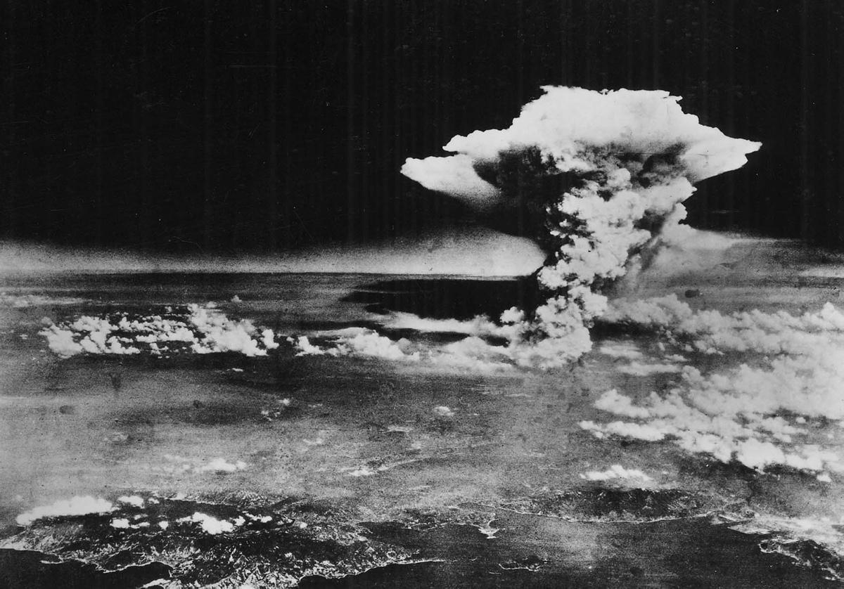
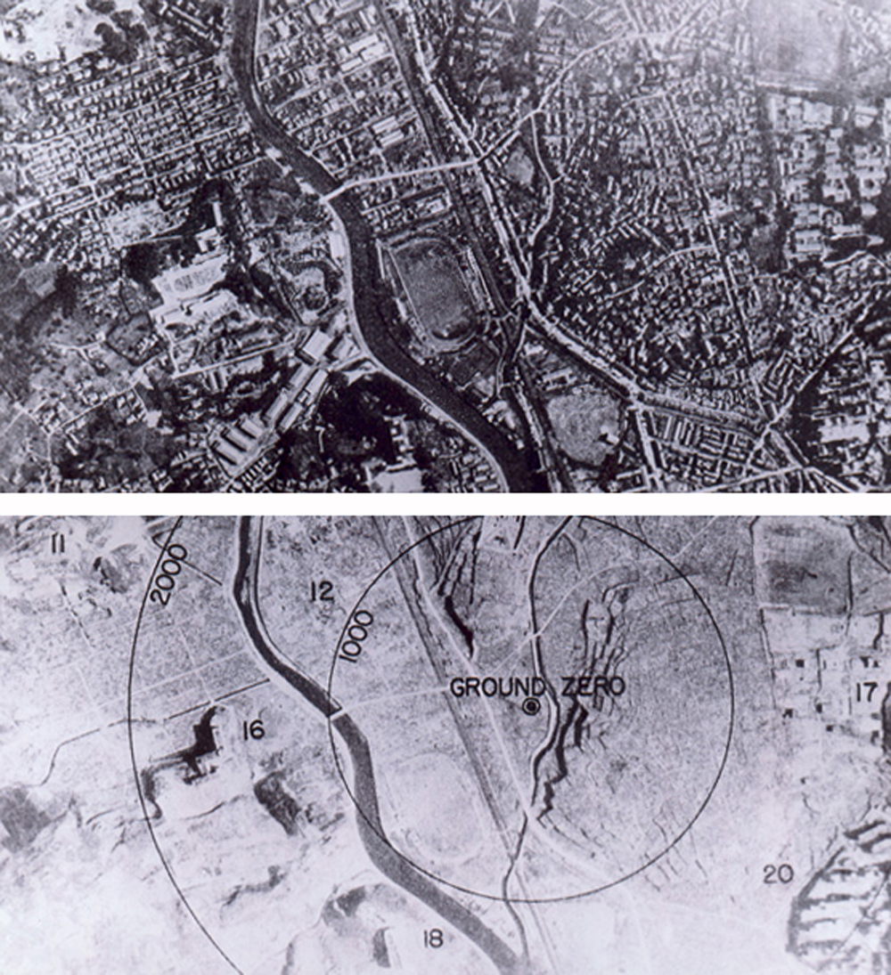
Effects of the Atomic Bomb

Slide 18
Effects of the Atomic Bomb
August 6, 1945, Little Boy is dropped on Hiroshima
140,000 people killed from initial explosion and radiation poisoning
August 9, 1945, Fat Man is dropped on Nagasaki
70,000 people killed from initial explosion and radiation poisoning

Slide 19
Why did many Americans fear that the end of World War II would bring on another depression? What steps did Congress take to prevent this from happening?
What was the Cold War? Why did the Soviet Union want a "buffer zone" with Europe? What was the rationale on both sides of the conflict?
How is the Cold War different from WWI and WWII?
What's the significance of the Truman Doctrine?
What the significance of the Marshall Plan?
What's the significance of China and its growing influence in the world?

